Slide 1
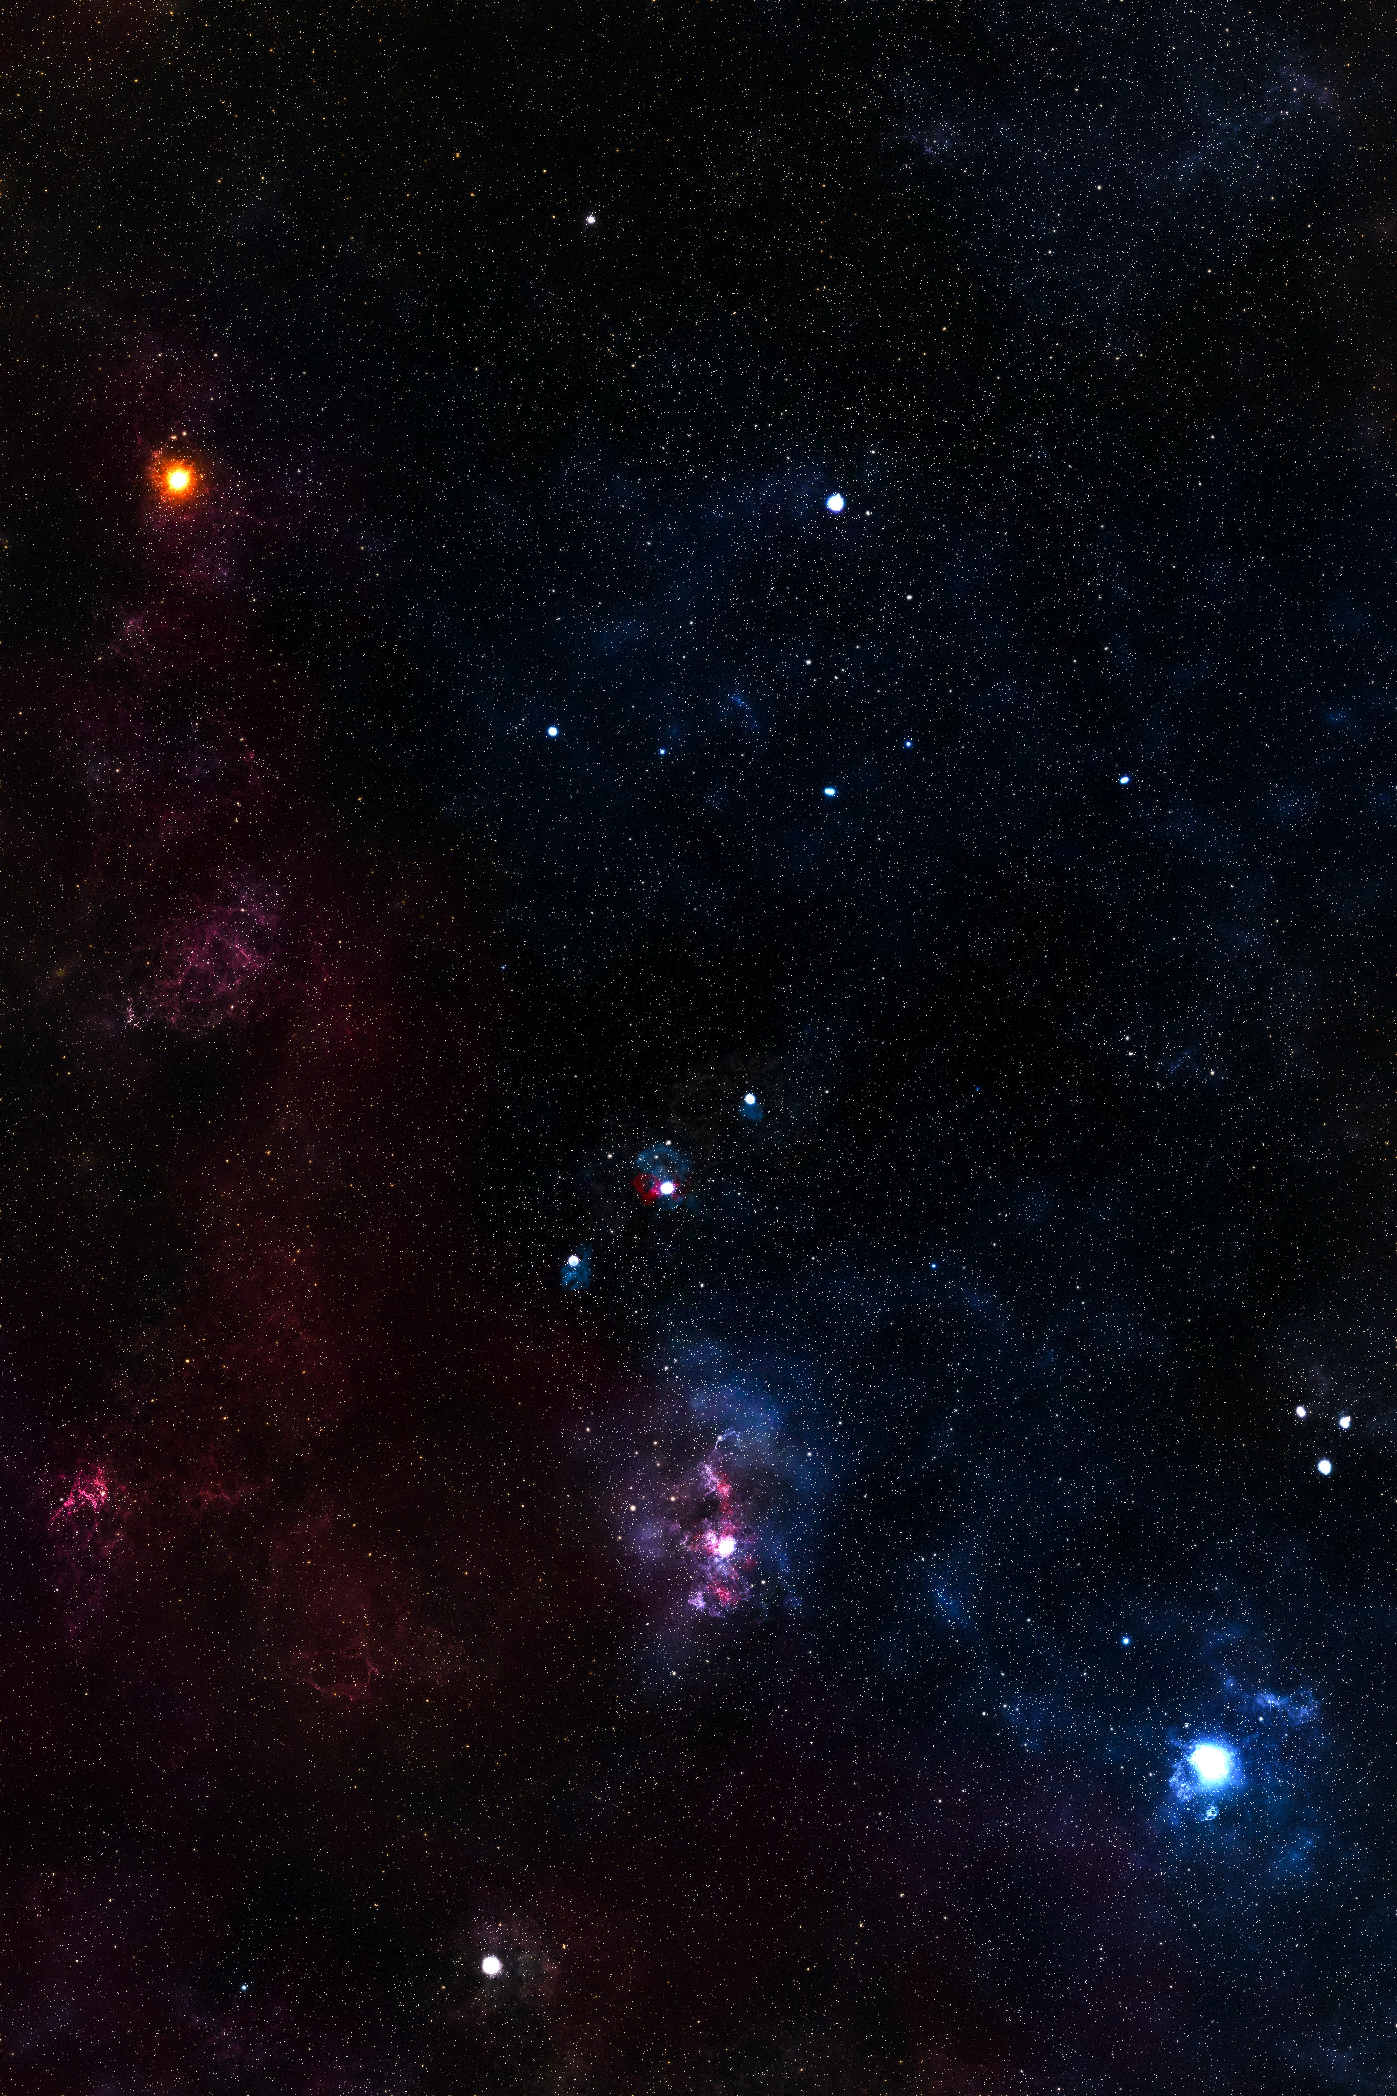
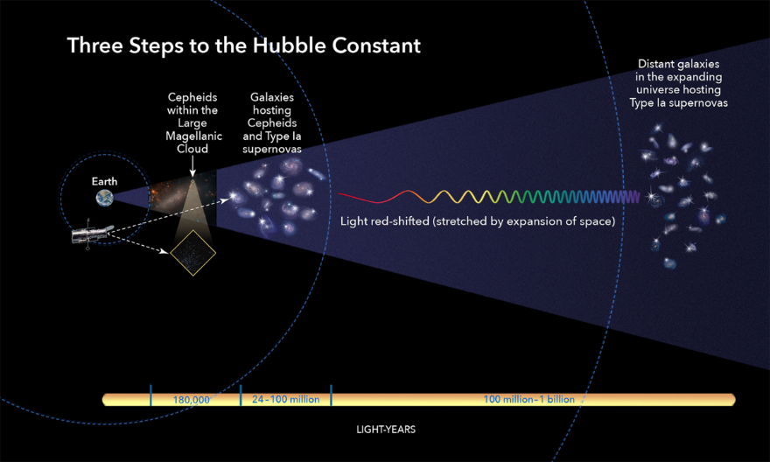
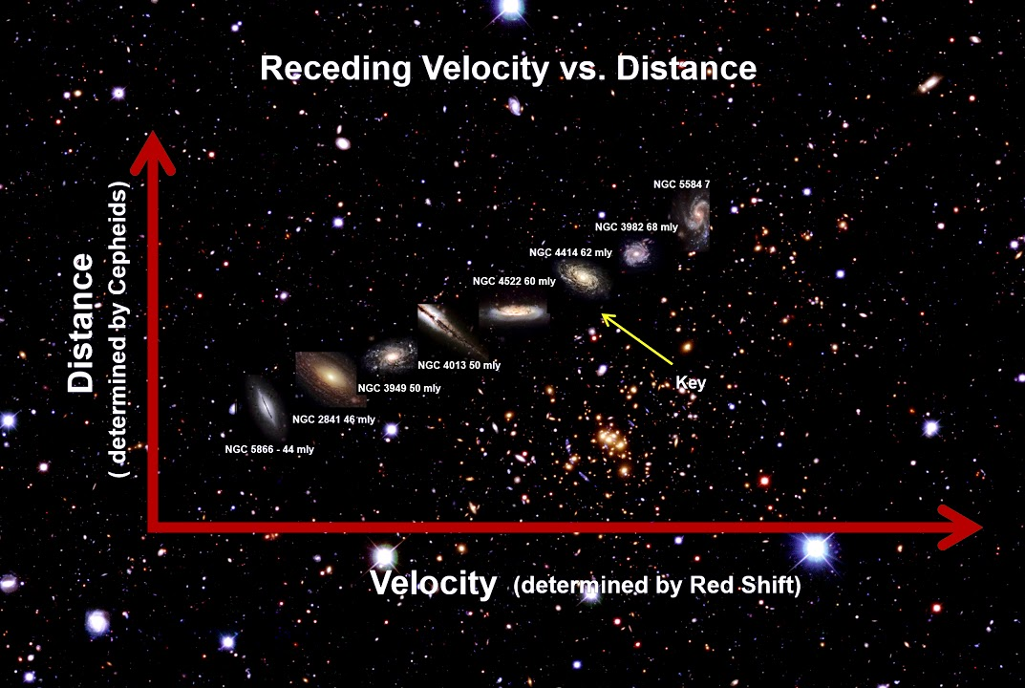
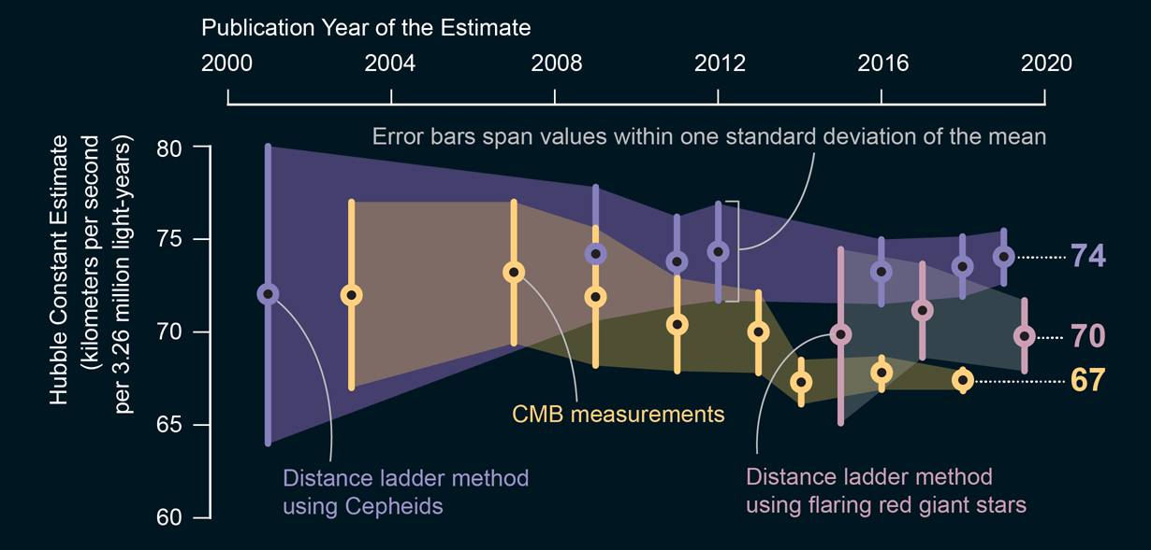
Tishk International University
Education Faculty
Physics department
Prepared by: Mohammed Aziz
and Hamza Ramadhan
Supervisor: Dr. Esmail Musa
Hubble’s law
The history of Hubble's law:
Along history astronomers thought that space and the universe is static, does not change. Because there was no observable change. However in 1915 an Astronomer named Vesto Slipher detected the red-shift of neighboring galaxies, but he did not know what does it meant. As well theoretically Alexander Friedman basing on the general relativity theory predicted that the universe must be dynamical. All of these remained un noticeable, until 1928 when Edwin Hubble proved that galaxies have red-shift, which implied that they are moving apart from one another and the universe is expanding.
Doppler effect for light: $$\frac{λ_{f}−λ_{i}}{λ_{i}}=\frac{V}{C}$$
Red-shift:
Doppler effect is a formula that describes how much the wavelength or the frequency of the source shift if the observer moves apart or towards it. As well this formula can be used for light since light is a wave, and galaxies are moving apart from one another, therefore using this formula we can determine their velocity.
Expansion of the universe:
Hubble used standard candle to determine the distance of the galaxies (which it is determining their distance using their luminosity), and basing on the redshift that the light of the galaxies have, Hubble was able to put a formula that, which known as Hubble’s law, since the farther the galaxies are, the more redshift they will have, thus by knowing the red-shift we can determine their distance form us as well.
Which later scientists interpreted it as the expansion of the universe, which has a constant rate known as Hubble’s constant, that states the expansion is 70 km/s for one million parsec.
$$V=Ho ×D when \text{H}\text{ = 70}\text{km} \text{l} \text{s} \text{l} \text{1}\text{Mpc}$$
Crisis in cosmology:
Today astronomers are able to measure the expansion rate in several ways. Such as using Cepheids (luminosity of variable stars), Cosmic microwave Background Radiation, and using flaring red giant stars. Each one of them give a different expansion rate. Which it is unsolved puzzle until today.
Application of Hubble’s law:
This law can be used for several Astrophysical studies, such as determining the age of the universe, the distance of the galaxies, the rate of expansion of the universe which implies the big bang theory, and the geometry of the universe. The age of the universe, using Hubble’s law: $V=\frac{D}{T}=Ho ×D ==⇒ T=\frac{1}{Ho}≈14 billion years$
Reference: Introduction to astronomy and cosmology.

