Slide 1
TISHK INTERNATIONAL UNIVERSITY
Faculty of Education
Biology Department
2019- 2020
Lab.6
Worms: Phyla
Platyhelminthes, Nematoda, Annelida.
(2nd Grade)
By: Yad Sirwan
yad.Sirwan@ishik.edu.iq

Slide 2
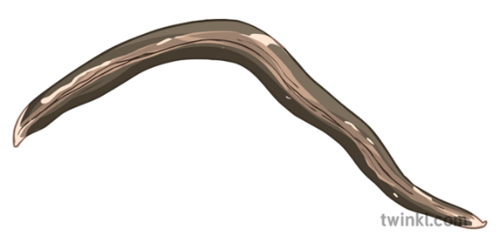
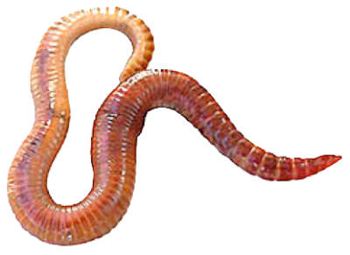
INTRODUCTION TO WORMS:
Worms are typically long, this creatures that get around efficiently without legs. They are invertebrate animals with bilateral symmetry. The different phyla of worms display a great range in size, complexity, and body structure.
Flatworms (phylum Platyhelminthes) are simple animals that are slightly more complex than a cnidarian.
Roundworms (phylum Nematoda) have a slightly more complex body plan.
Segmented worms (phylum Annelida) are the most complex animals with worm-like body plans.

Slide 3
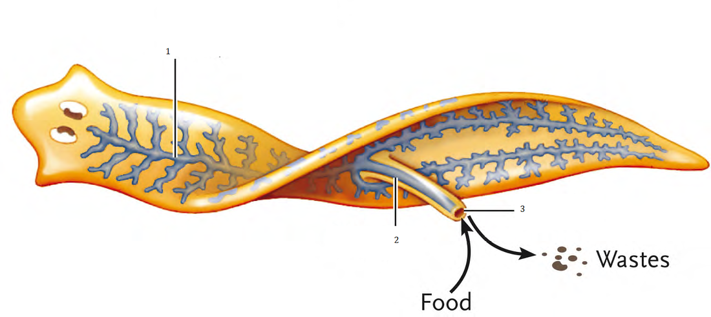
FLATWORMS: PHYLUM PLATYHELIMENTHIS
General characteristics of Flat Worms:
Bilateral symmetry and body is flattened dorsoventrally.
Triploblastic: having a body derived from three embryonic cell layers (ectoderm, mesoderm, and endoderm).
Acoelomate.
Unsegmented.

Slide 4
Flat Worm Body System
Digestion & Excretion
Nervous System
Digestion, Excretion, Reproduction
Parasitic species are less develop.
Common opening (Mouth & Anus).
Flame cells excrete waste through pores.
Hermaphrodites.
Transverse fission (asexual).
Parasitic species have multiple hosts & larva stage.

Slide 5
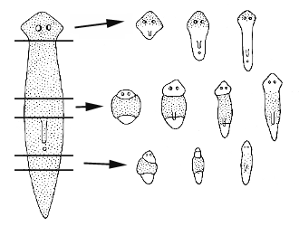
REGENERATION:
Many species can regenerate or repair wounds.
https://www.youtube.com/watch?v=hTC1eNTBXvE

Slide 6
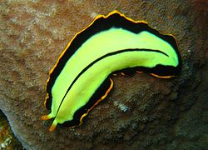
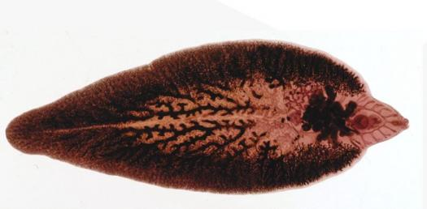
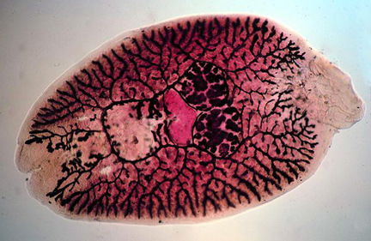
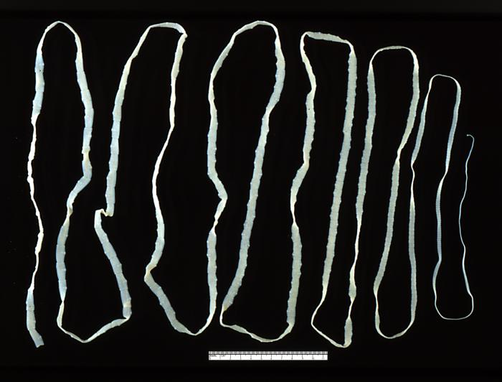
FLATWORM DIVERSITY – 4 CLASSES
Turbellaria
Free-living.
Monogenea
External parasites with one generation lifecycle.
Cestoidea
Parasitic species with a scolex (anchor to host.
Trematoda
Predators.
Parasitic of other animals with a leech-like body.
Ex: Flukes.
Ex: Planaria.
Ex: Monogenetic Flukes.
Proglottids (reproduction).
Ex: Tapeworms.

Slide 7
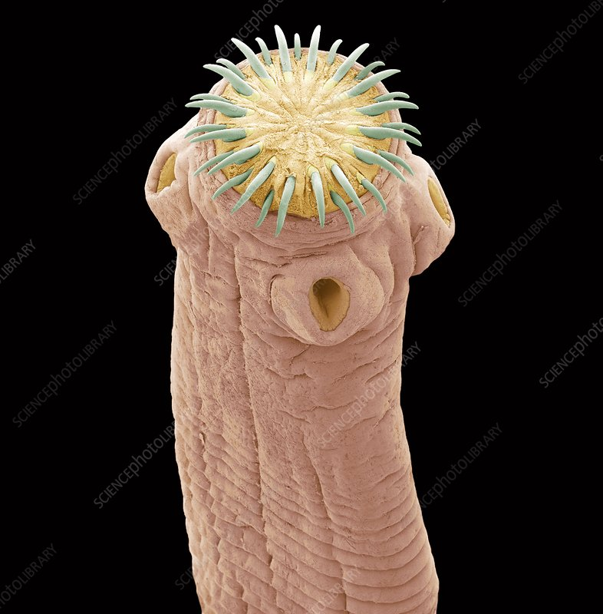
How to be an effective parasitic worm?
Good attachment.
High reproduction output.
Multiple hosts & generations (Primary host and Intermediate host)

Slide 8
ROUNDWORMS: PHYLUM NEMATODA
General characteristics:
Triploblastic.
They have a complete digestive system.
They have a Cuticle, which is s a waxy covering secreted by the epidermis, or outermost cellular tissue.
nematodes do have a space in the body between the digestive tract and the body wall, it is not lined with tissue and is not considered to be a true coelom. Thus, nematodes are sometimes referred to as pseudocoelomates.

Slide 9
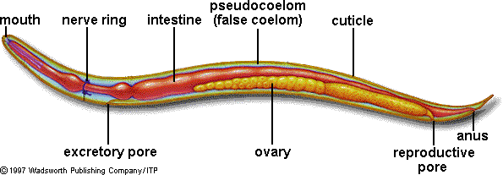
They have longitudinal muscles that run the length of the body.
They are dioecious ( Sexes are separate).

Slide 10
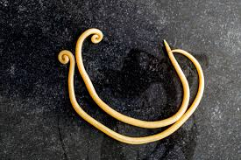
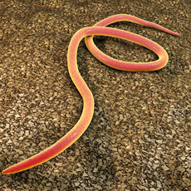
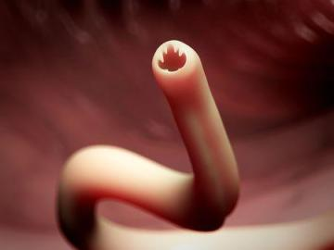
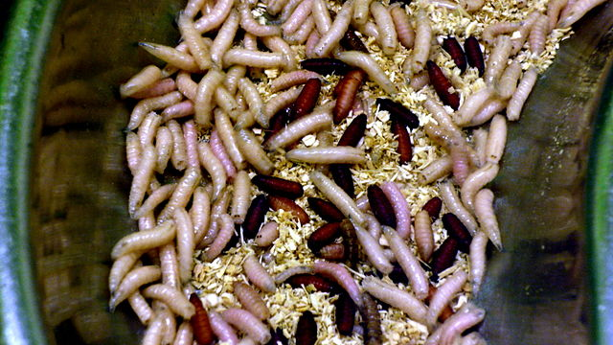
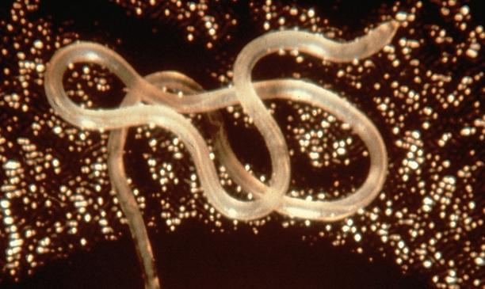
PARASITIC ROUNDWORMS:
Ascaris
Live in small intestine of humans.
Porkworm
Live in small intestine then larva move to skeletal muscles and lay dormant.
Filarial worms
Live in lymphatic system and block vessels.
Pinworms
Hookworm
Most common roundworms in US
Live in large intestine.
Frequently penetrate in between toes and then live in circulatory system.

Slide 11
SEGMENTEDWORMS: PHYLUM ANNELIDA
The body of an annelid is divided into repeating sections called segments with many internal organs repeated in each segment
They have central nervous system, and an excretory system. Each of these systems is more complex in the Annelid than in Flatworms or Nematodes. In addition to a more specialized complete digestive system, annelid worms have also evolved body features not found in flatworms or nematodes. These features appear in some form in all larger, more complex animals:
a coelom, a body cavity between the digestive tube and the external body wall that is lined with tissue
a circulatory system consisting of a series of tubes (vessels) filled with fluid (blood) to transport dissolved nutrients, oxygen, and waste products rapidly and efficiently
Triploblastic.
One or more pairs of Setae is present.

Slide 12
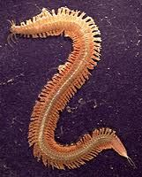
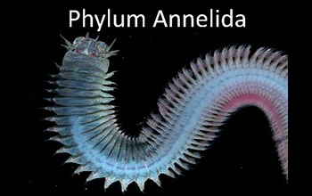
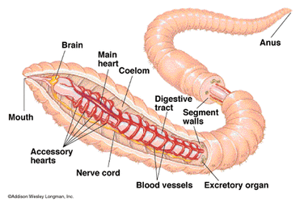

Slide 13
SEGMENTEDWORMS BODY SYSTEM
Digestive
Complete system
Nervous system
Pair of ganglia
Reproductive
Dioecious, most species have external fertilization.
External
Epidermis with a mucus gland.
Longitudinal & circular muscle.
Pharynx, crop, gizzard (more evolved than other phyla
Double ventral nerve cord.
Sense organs for chemicals, gravity and touch

Slide 14
SEGMENTEDWORMS DIVERSITY
Class Errantia
Marine species, burrow in sand/coral
Class Sedentria
Marine species, tube-dwelling.
Class Clitellata
Terrestrial species
Ex: Sand worms, bloodworms.
Ex: Tubeworms, breadworms.
Ex: Earthworms, Leeches.

Slide 15
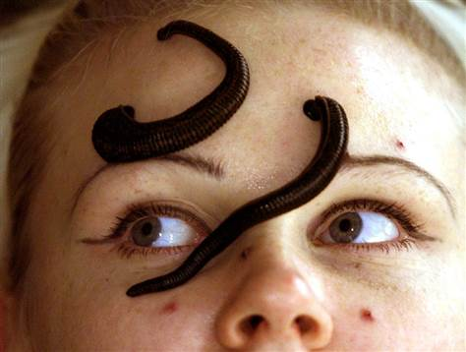
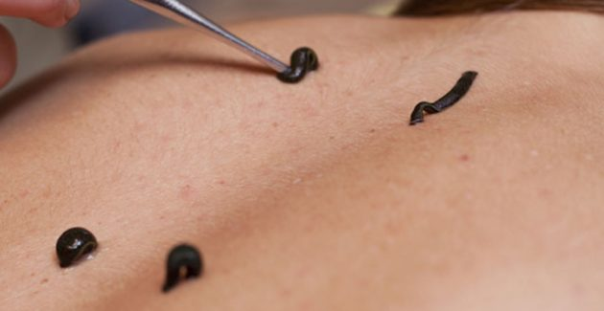
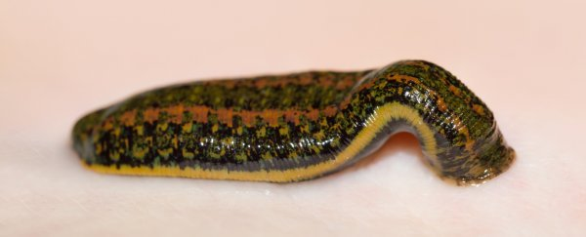
LEECHES – NATURE’S MEDICINE
Anterior sucker with mouth & posterior sucker for attachment
Salivary gland contain Hirudin to prevent blood clotting.
19th century uses for Bloodletting.

Slide 16
Thank you

