Slide 1
TISHK INTERNATIONAL UNIVERSITY
Faculty of Education
Biology Department
2019- 2020
Lab.4
Porifera
(Sponges)
(2nd Grade)
By: Yad Sirwan
yad.Sirwan@ishik.edu.iq

Slide 2
Objectives
Define Porifera.
Understanding Porifera characteristics.
Identify parts and shapes of Porfera.

Slide 3
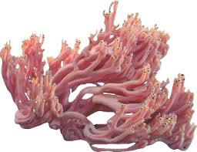
Phylum Porifera overview
Porifera means “pore-bearing” and refers to the numerous pores and channels that permeate a sponge’s body.
From few cm to over 1 m in size.
All sponges are aquatic, marine or freshwater.
Sponges
Over 5000 species.
2% of all sponges are fresh water sponges.

Slide 4
General characteristics of Sponges
Most primitive of the multi cellular animals.
No tissue or organs.
Made up collection of cells.
They are sessile, so they depend upon the water drawn through these tiny pores and canals for obtaining food and oxygen and eliminating wastes.
Mostly asymmetrical in shape.
They are Hermaphrodites (individuals produce both male and female gametes at different times).
They eat bacteria, microscopic algae, Protists, and suspected organic matter.

Slide 5
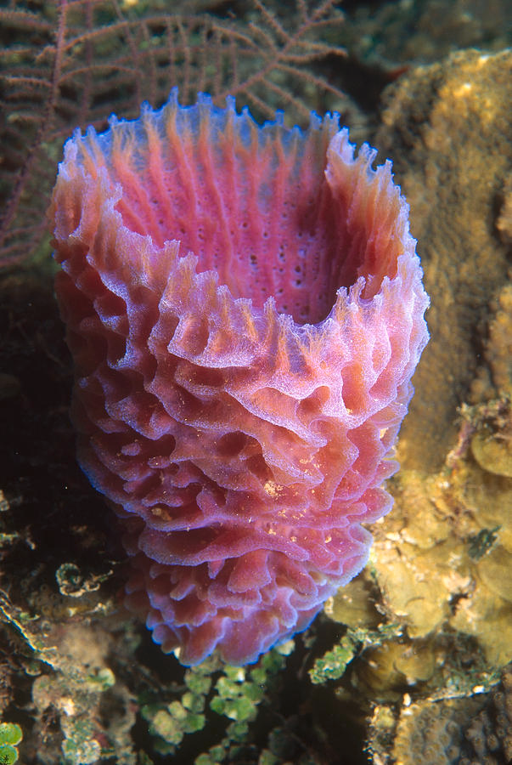
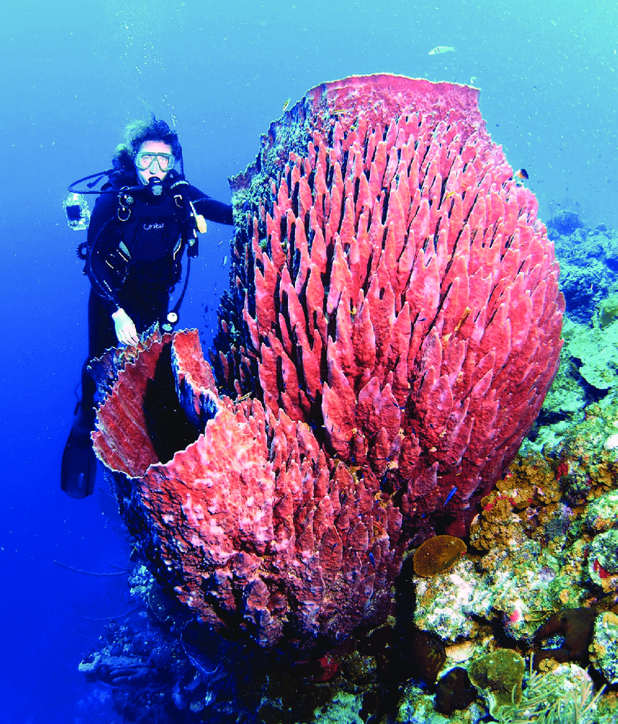
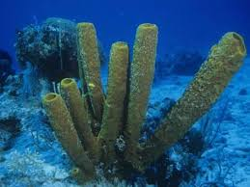
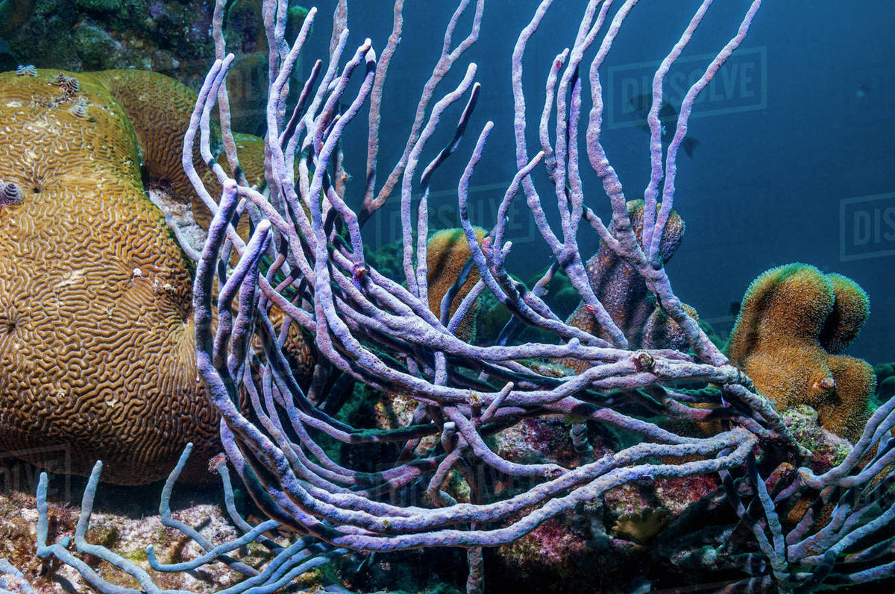
Sponge diversity
Tube sponge
Vase sponge
Barrel sponge
Rope sponge

Slide 6
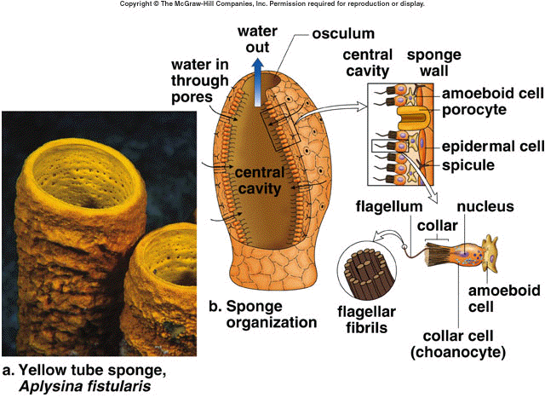
Porifera Anatomy

Slide 7
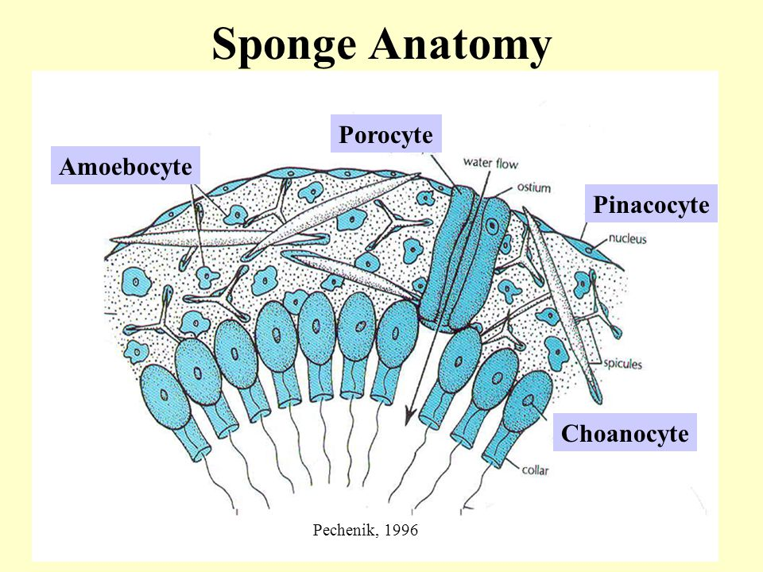
Porifera anatomy – Cell types
Pinacocytes: Thin, flat cells tat line the outer surface of sponge.
Some pinacocyte are specialized into tube like cells called porocytes.
Porocytes: create the pores that connects inside to the outside of sponges and regulate water circulation.
Choanocytes (collar cells): act as a pump to bring water into the sponge.
Create water current for filter feeding

Slide 8
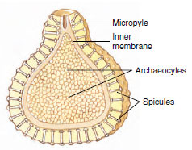
Porifera anatomy – Cell types
Archaeocytes: Cells move around in the mesohyl and can specialize to other functions including:
Reproduction.
Can differentiate into other specialized cell types.
Storing and transporting foods.
Secreting skeletal elements.

Slide 9
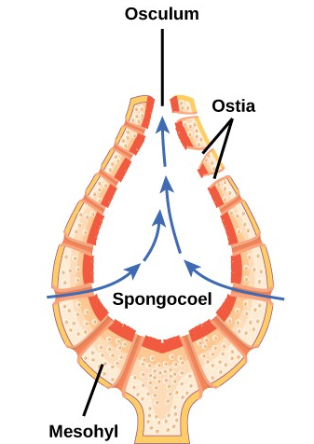
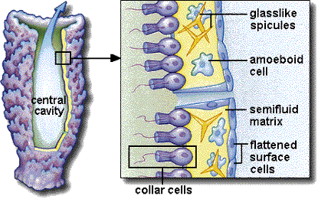
Porifera anatomy – Sponge support
Mesohyl
Collagen found between the inner canals and chambers
Amoeboid cells
Located in the mesohyl, have different rules.
Ex: Archaeocyte (Amoeboid” stem cells”), create spicules.

Slide 10
Porifera anatomy – Skeleton types
It made of Spongin which is soft and flexible or Spicules which is feel prickly, or both combined.
Note: Spicules is made of calcium carbonate, silica or spongin [collagen].

Slide 11
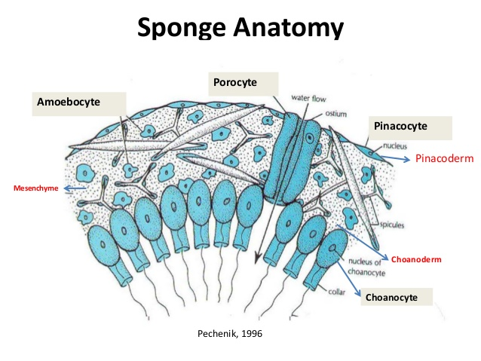

Slide 12
sponges water current
Water enters the body of a sponge pores or ostia. Water leaves the body by way of one or more large pores or oscula.
Water current bring food & Oxygen, and take metabolic & digestive wastes.
https://www.youtube.com/watch?v=RmPTM965-1c&t=7s

Slide 13
Sponge body construction
Sponges may be divided into three basic grades or types based upon the arrangement of their water canal systems.
Asconoid
Simplest body plan, least common type, water enter the ostia and exit from the oscula.
Syconoid
more chamber, choanocytes line the canal instead of spongocoel.
Leuconoid
More complex, folded & twisted, no spongocoel present

Slide 14
Porifera reproduction
Asexual: By Budding.
Regeneration: Can regenerate from broken parts.
Survival pods: Unspecialized cells that remain dormant until conditions improve.
Sexual reproduction: Hermaphroditic (sponges can’t self fertilize because egg and sperm are produced at separate times).

Slide 15
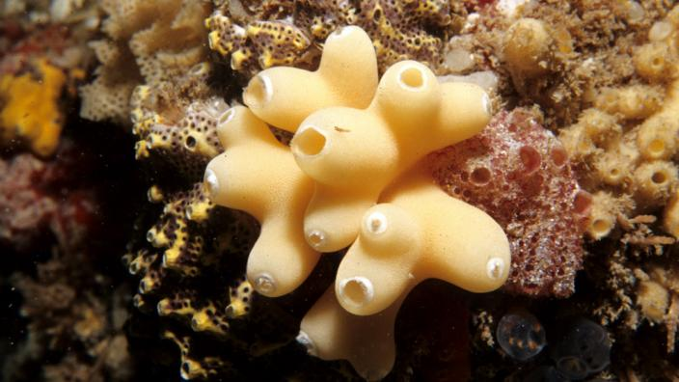
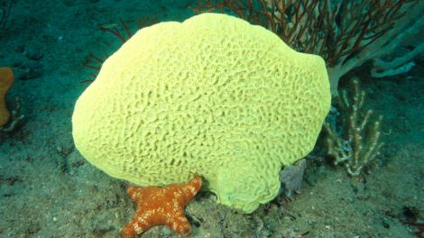
Porifera classes
Class Calcarea:
contains sponges having calcareous spicules (Never contain sponging)
Mostly small in size (<15 CM)
Class Demospongeia:
Have spicules made of silicon dioxide, spongin, or a combination of both.
Most sponges belong to this class.

Slide 16
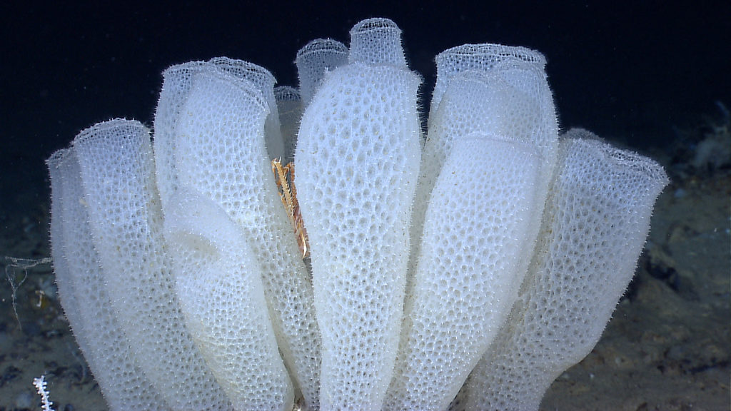
Porifera classes
Class Hexactinellida:
Spicules made of silica.
Usually found in deep water.

Slide 17
Thank you

