Slide 1
Biochemistry lab 3
Sayfeddin Saad
sayfaddin.saad@ishik.edu.iq

Slide 2
THINGS TO DO TODAY
To understand
- the structural features of amino acids
- the classifications of amino acids
- the properties of amino acids
- the determination of amino acids (experiment)

Slide 3
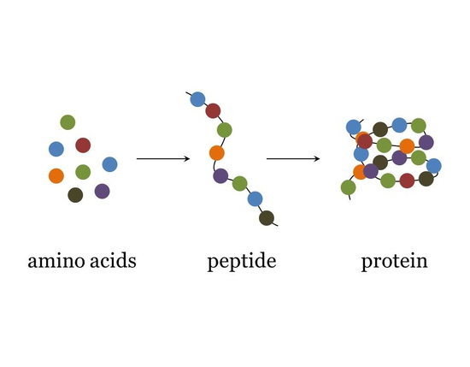
First thing first
If you understand amino acid you will understand every thing !!!!!!

Slide 4
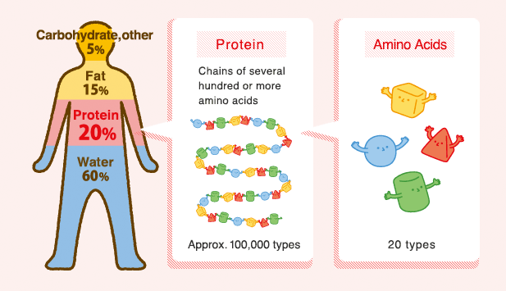
Introduction to Amino acid
Amino acids are the building block of protein
There are 20 naturally occurring amino acids
Important

Slide 5
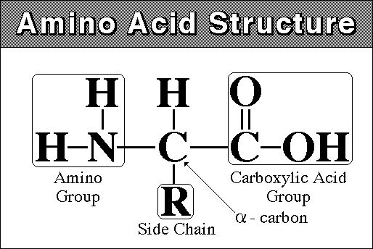
Structural and features of Amino acids
Important
All 20 amino acids have common structural features
All amino acids have an amino group (-NH₃⁺), a carboxylate (-COO⁻) group and a hydrogen bonded to the same carbon atom (the α -carbon)
They differ from each other in their side chain called R group.
R groups vary in structure, size and electric charges and influence the solubility of amino acids in water.

Slide 6
There are many ways to characterize the properties of amino acids.
The ones most useful and most commonly used are:
Hydrophobicity
Size
Charge
Secondary structure preference
Alcoholicity
Aromaticity
Important

Slide 7
Classification of Amino Acids
Nutritional Based on R group
- Essential - Non polar aliphatic R group
- Non-essential - Polar uncharged R group
- Aromatic R group
- Positively charged R group
- Negatively charged R group
Important

Slide 8
Nutritional Classification of Amino acids
Essential Amino Acids:
Need to supplied in daily diet
Lysine
Leucine
Isoleucine
Methionine
Tryptophan
Phenylalanine
Threonine
Valine
Nonessential Amino Acids:
Need not be supplied in daily diet
Alanine
Asparagine
Glycine
Tyrosine
Serine
Proline
Cysteine
Cystine
Histidine(essential for children)
Glutamine(conditionally essential)
Arginine(conditionally essential)
Glutamate

Slide 9
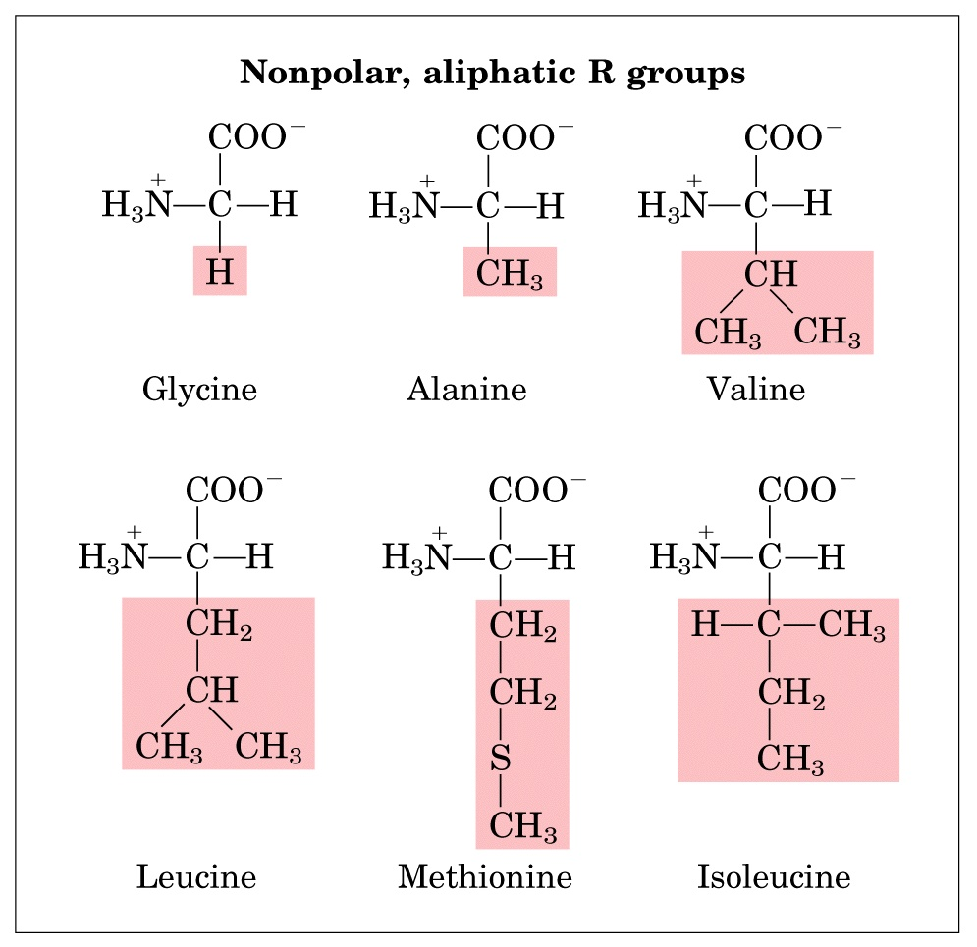
Classification of Amino acids Based on R group
The hydrocarbon R group in this class of amino acids is nonpolar and hydrophobic.
Glycine has the simplest amino acid structure.
The bulky side chain of valine, isoleucine and leucine are important in promoting hydrophobic interactions within protein structures.

Slide 10
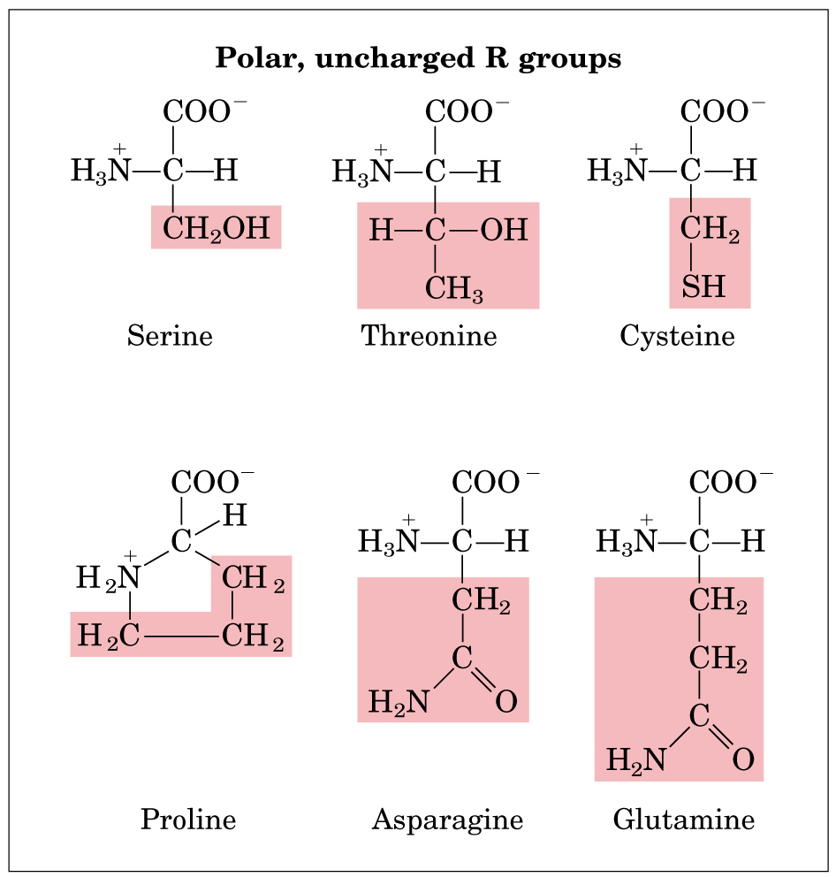
The R group of these amino acids is more soluble in water, or hydrophilic than those of non polar amino acids, because they contain functional groups that form hydrogen bond with water

Slide 11
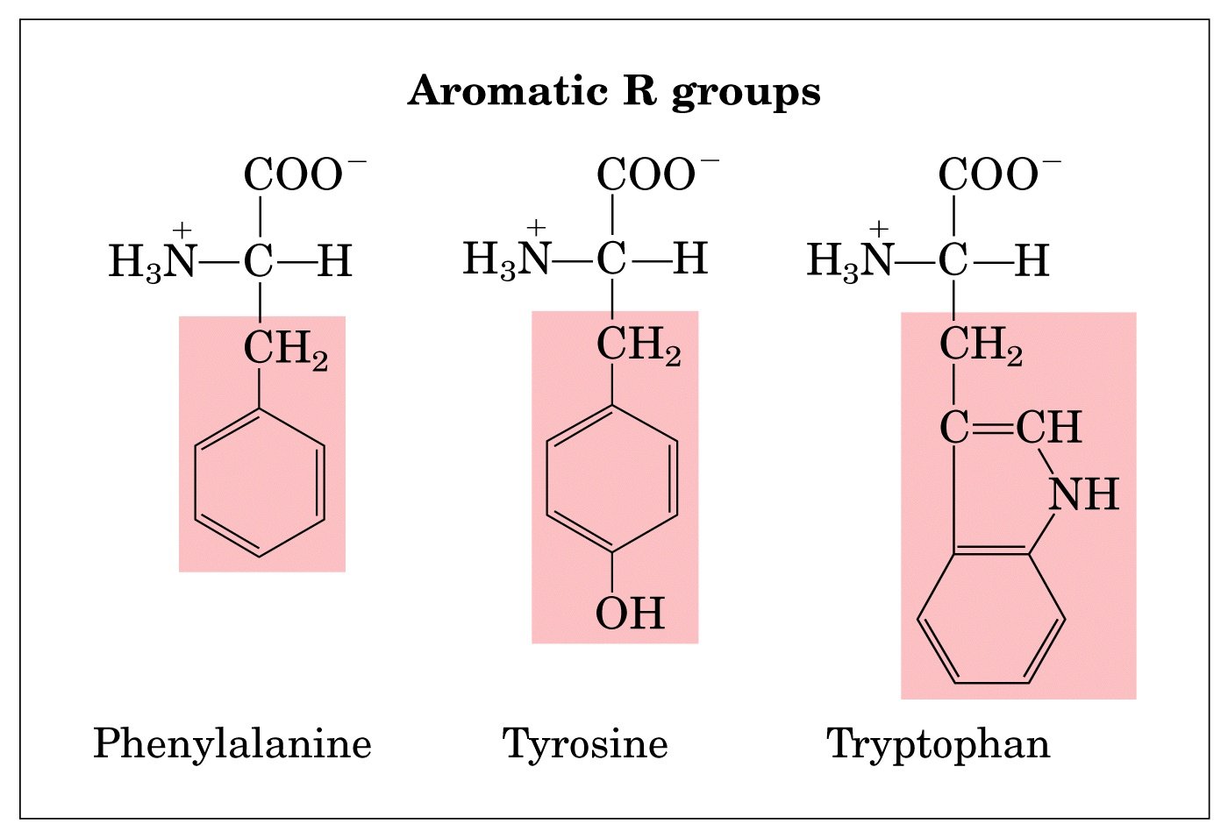
Their aromatic side chains are relatively nonpolar.
All can participate in hydrophobic interactions.
The OH group of tyrosine can form hydrogen bond and can act as an important functional group in the activity of some enzymes.

Slide 12
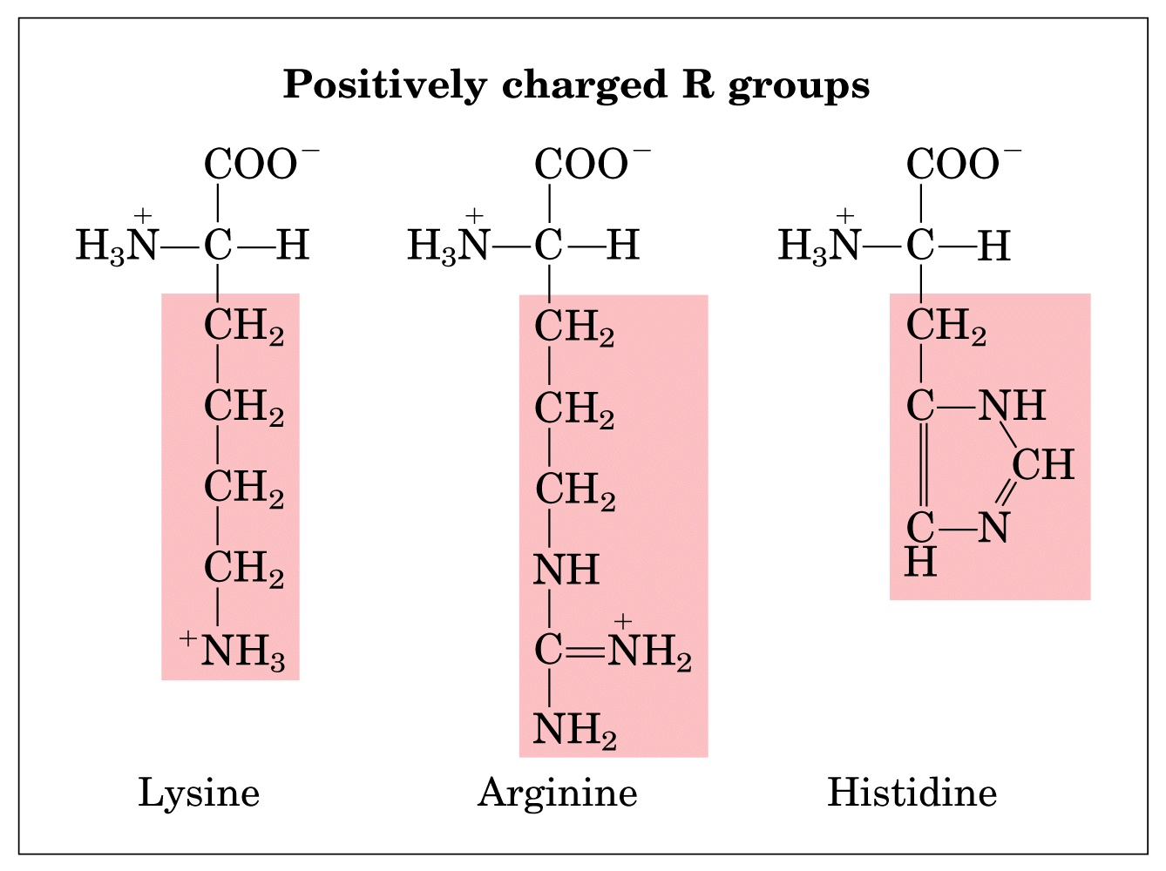
The amino acids in which the R group have a net positive charge at pH 7.0

Slide 13
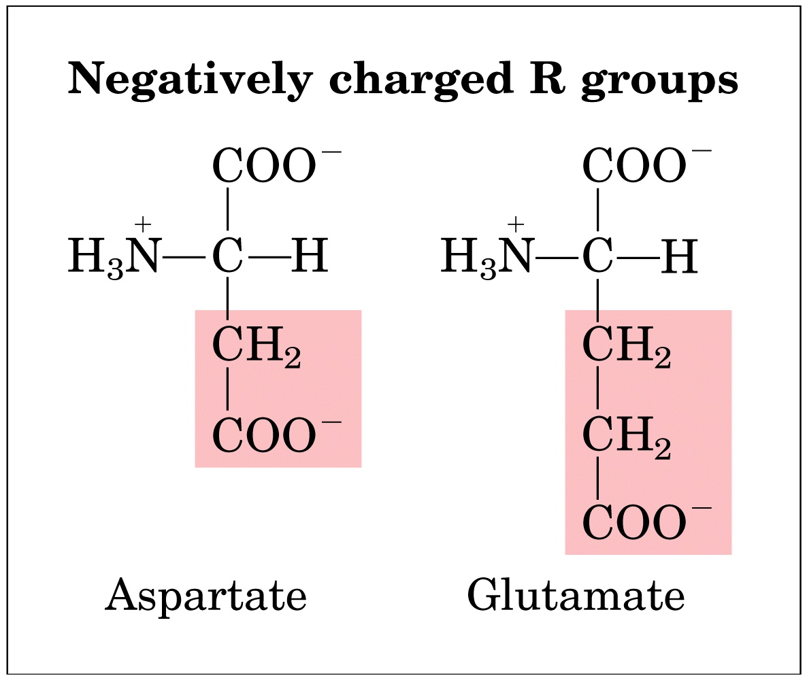
Amino acids having R group with a net negative charge at pH 7.0, with a second carboxyl group

Slide 14
Properties of amino acids…
All the amino acids except glycine have handedness (chiral)
Amino acids exist as D or L form that are mirror image of one another
L-form naturally occurs in proteins
Amino Acids are linked to form peptide
The condensation of the carboxylic group of one amino acid with the amino group of another amino acid releases a water molecule and forms a peptide bond or peptide link
Important

Slide 15
Experiment time

Slide 16
Purpose, principle, problem
This test is a general test and thus given by all amino acids.
This test is due to a reaction between a amino group of free amino acid and ninhydrin.
This test is used to determine amino acid
Hypothesis
Ninhydrin is a powerful oxidizing agent and its presence, amino acid undergo oxidative deamination liberating ammonia, CO2, a corresponding aldehyde and reduced form of ninhydrin ( hydrindantin).
The NH3 formed from a amino group reacts with another molecule of ninhydrin and is reduced product ( hydrindatin) to give a blue substance diketohydrin ( Ruhemanns complex).
However, when proline or glutamine react with nihydrin a product of a bright yellow color is formed.

Slide 17
Material or requirement
test solution: 1 % proline or Glutamine
2 % ninhydrin in acetone
10 ml acetone
5 ml Distil water
Water bath
Dry test tubes
Pipettes
Scale
Control test solution

Slide 18
Procedure
i. Preparation of 2% ninhydrin solution:
weight 0.2 gm of Ninhydrin and dissolve in 10ml of acetone or ethanol
ii. Preparation of test solution:
prepare 1% amino acid solution in distilled water.
Take 5 ml test solution in dry test tube and 5 ml distilled water in another tube as a control.
pour few drops of 2% ninhydrin in both the test tubes
Keep the test tubes in water bath for 5 minutes.
Look for the development of blue or violet color.

Slide 19
Results

Slide 20
Result

Slide 21
Have a good day a head
“Be the change you want to see”
sayfaddin.saad@ishik.edu.iq

