Slide 1
TISHK INTERNATIONAL UNIVERSITY
Faculty of Education
Biology Department
2019- 2020
Lab.1
Microscope
(2nd Grade)
By: Yad Sirwan
yad.Sirwan@ishik.edu.iq

Slide 2
Objectives
Explain the term Microscope.
Distinguish the different types of microscopes.
Understand the rules of using the microscope.
Identify the different parts of the microscope.

Slide 3
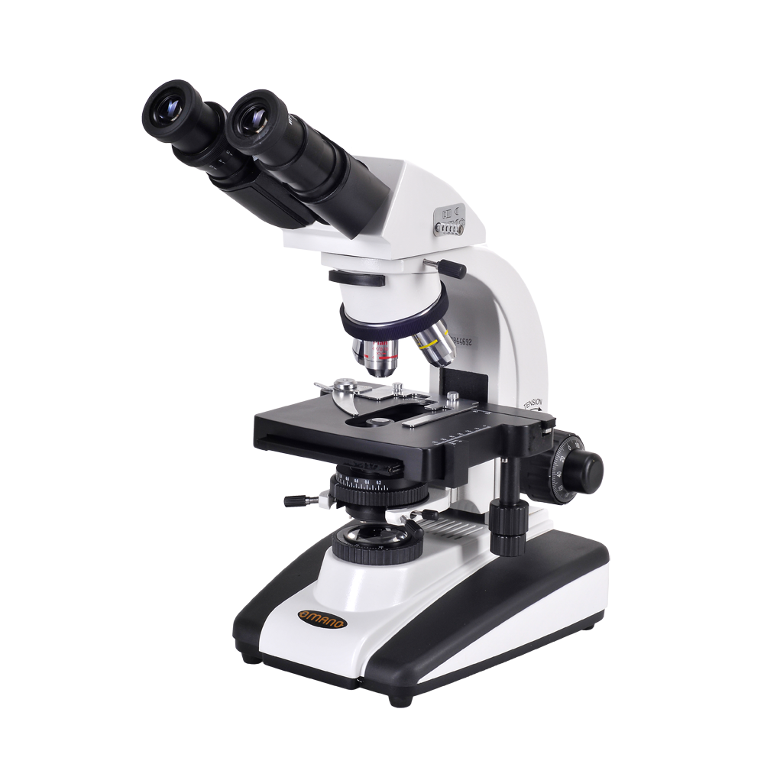
What is a microscope?
A microscope (from the Ancient Greek: μικρός, mikrós, "small" and σκοπεῖν, skopeîn, "to look" or "see") ,mean (seeing small things).
A microscope is a piece of scientific equipment that helps us to see things that are invisible to the naked eye, because they are so small.
Many types of microscopes exist, allowing different levels of magnification and producing different types of images.

Slide 4
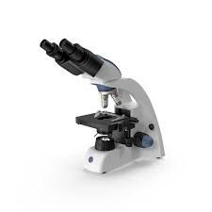
Types of Microscope
Compound Microscope
first type of microscope, most widely used. Light passes through two lenses.
Electron microscope
Used to observe VERY small objects: viruses, DNA, parts of cells.
Uses beams of electrons rather than light.
Much more powerful.

Slide 5
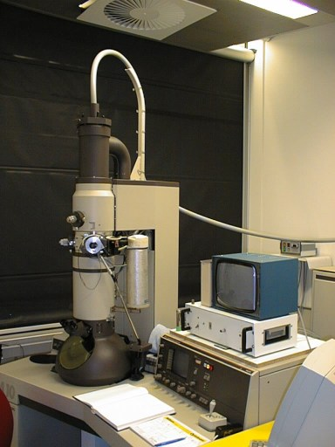
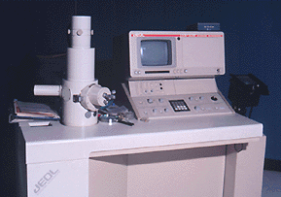
Types of Microscope
Scanning Electron Microscope (SEM)
SEM is used to examine Very thin section through the Cells and tissues. (Can magnify up to 250,000x)
Transmission Electron Microscope (TEM)
This type of electron microscopy Examine the surface of un-sectioned Specimen, it can show the sample in 3D, But not detailed as transmission electron microscopy.

Slide 6
Types of Microscope
Phase –constant microscope.
Fluorescence microscope.
Deconvolution microscope.
Interference microscope.

Slide 7
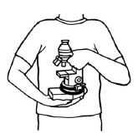
Rules of Using a Microscope
Always carry with two hands
Only use lens paper for cleaning
Do not force knobs
Always store covered

Slide 8
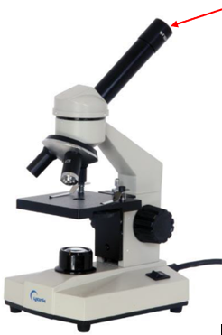
Parts of a Microscope
Eyepiece
The part where you look through to see the image of your specimen.

Slide 9
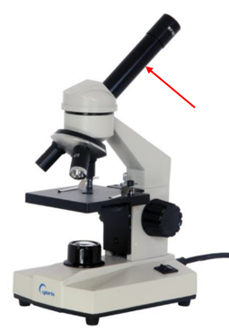
Parts of a Microscope
Body Tube
Connects the eyepiece to the objective lenses

Slide 10
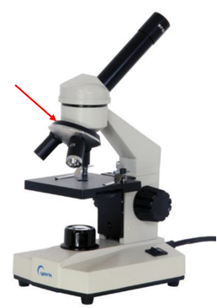
Parts of a Microscope
Nosepiece
Hold the objective lenses
Can be used in order to change the magnification

Slide 11
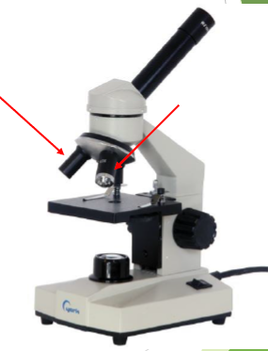
Parts of a Microscope
Objectives
Low Power (short)
High Power (long)
Usually you will find 3 or 4 objective lenses on a microscope. They almost always consist of 4X, 10X, 40X and 100X powers. When coupled with a 10X (most common)

Slide 12
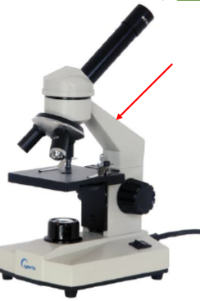
Parts of a Microscope
Arm
Supports the tube and connects it to the base of the microscope.

Slide 13
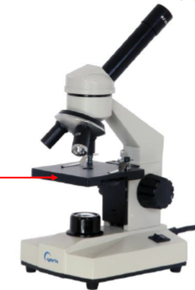
Parts of a Microscope
Stage
The flat platform where you place your slides

Slide 14
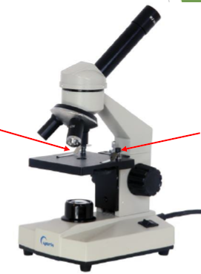
Parts of a Microscope
Stage Clips
Stage clips hold the slides in place.

Slide 15
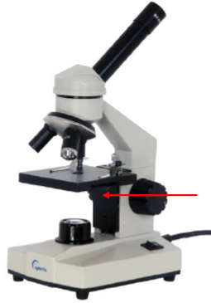
Parts of a Microscope
Diaphragm
Controls the amount of light going through the specimen

Slide 16
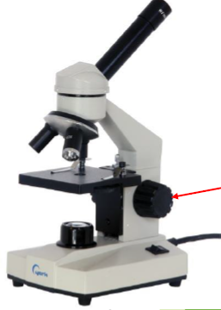
Parts of a Microscope
Coarse Adjustment Knobs
Moves stage (or body tube) up and down
Fine Adjustment Knobs
Used to fine-tune the focus of your specimen

Slide 17
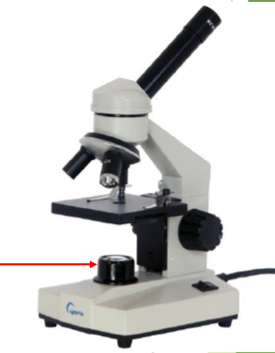
Parts of a Microscope
Light Source
Makes the specimen easier to see

Slide 18
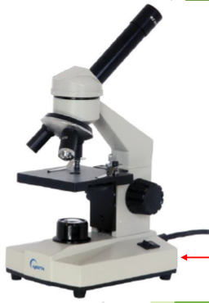
Parts of a Microscope
Base
The bottom of the microscope, used for support

Slide 20
Thank You!

