Slide 1
Biochemistry Acid, base & buffer
Sayfeddin saad
2 lab

Slide 2
Aims
To determine the difference between Acids & Bases, buffer solution
Discuss the importance of studying Acids & Bases
Perform an experiment dealing with Acids & Bases

Slide 3
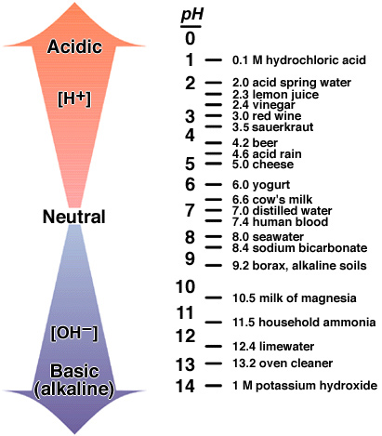
What is the pH scale?
The pH scale measures how acidic or basic a solution is.
The pH scale estimate the concentration of hydrogen ions in a given substance.

Slide 4
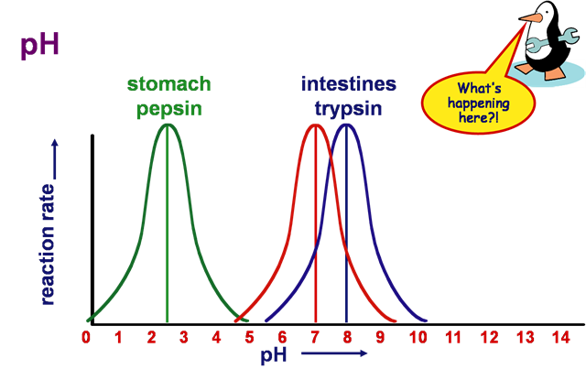
Why is pH important in biology?
pH affects solubility of many substances.
pH affects structure and function of most proteins - including enzymes.
Many cells and organisms (esp. plants and aquatic animals) can only survive in a specific pH environment.

Slide 5
base
Acid
Acids have a ph from 0 - 7
Lower pH value indicates a stronger acid.
An acid is a substance that breaks into [H+] ions in an aqueous solution.
React with metal
Acids can be characterized by:
A sour taste.
It turns blue litmus paper red
It tastes sour. Try drinking lemon juice (citric acid)
Bases have a pH from 7 - 14
Higher pH value indicates a stronger base.
A Base (alkaline) is a substance that breaks into [OH-] ions in an aqueous solution.
Don’t react with metal
A Base is characterized by:
A bitter taste. (Milk of Magnesia)
It feels slippery. (Soapy Water)
It turns Red Litmus Blue.
Note: aqueous solution is any solution where H2O is the solvent.

Slide 6
Buffers
Definition: a solution that resists change in pH
Typically a mixture of the acid and base form of a chemical
Can be adjusted to a particular pH value
Blood: pH = 7.35-7.45
Too acidic? Increase respiration rate expelling CO2, driving reaction to the left and reducing H+ concentration.
Excretory system – excrete more or less bicarbonate
pH below 7.4 in rats – CaCO3 in BONE dissociates, carbonates soak up extra H+ to buffer blood. But bones weakened.

Slide 7
How buffers work
Equilibrium between acid and base.
Example: Acetate buffer
CH₃COOH ↔ CH₃COO⁻ + H⁺
If more H⁺ is added to this solution, it simply shifts the equilibrium to the left, absorbing H⁺, so the [H⁺] remains unchanged.
If H⁺ is removed (e.g. by adding OH-) then the equilibrium shifts to the right, releasing H⁺ to keep the pH constant

Slide 8
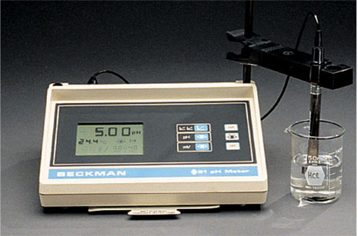
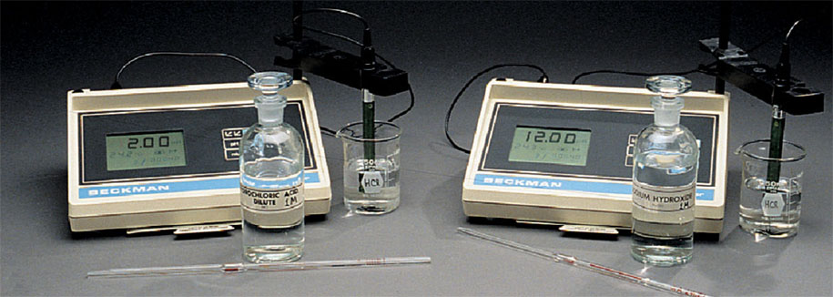
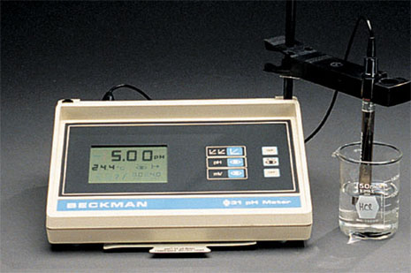
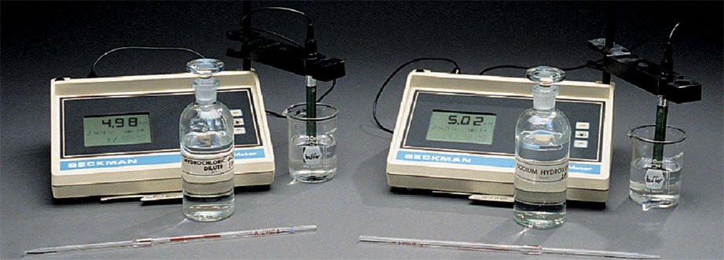
an unbuffered solution.
a buffered solution.

Slide 9
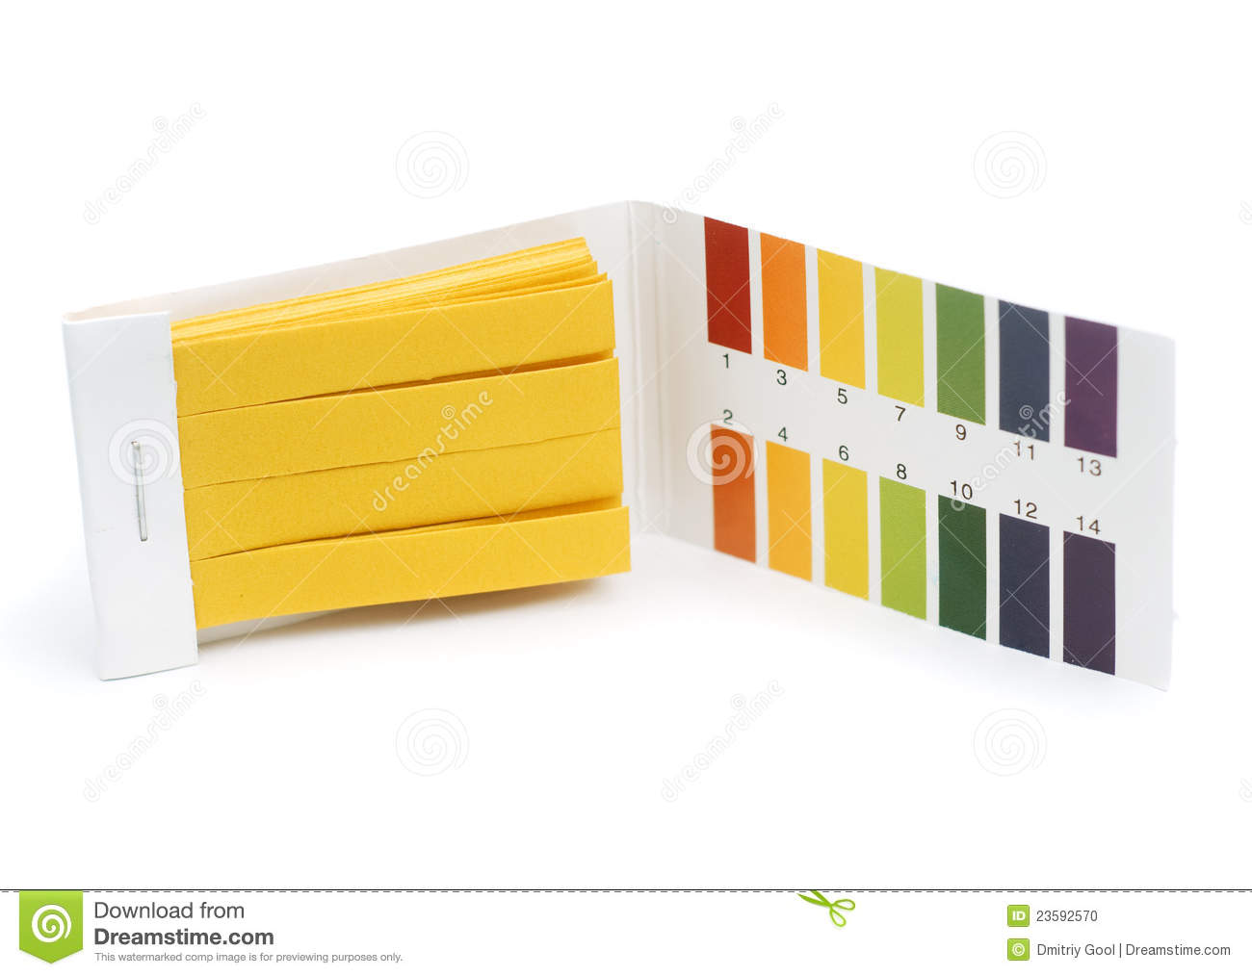
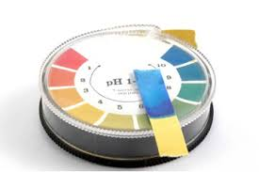
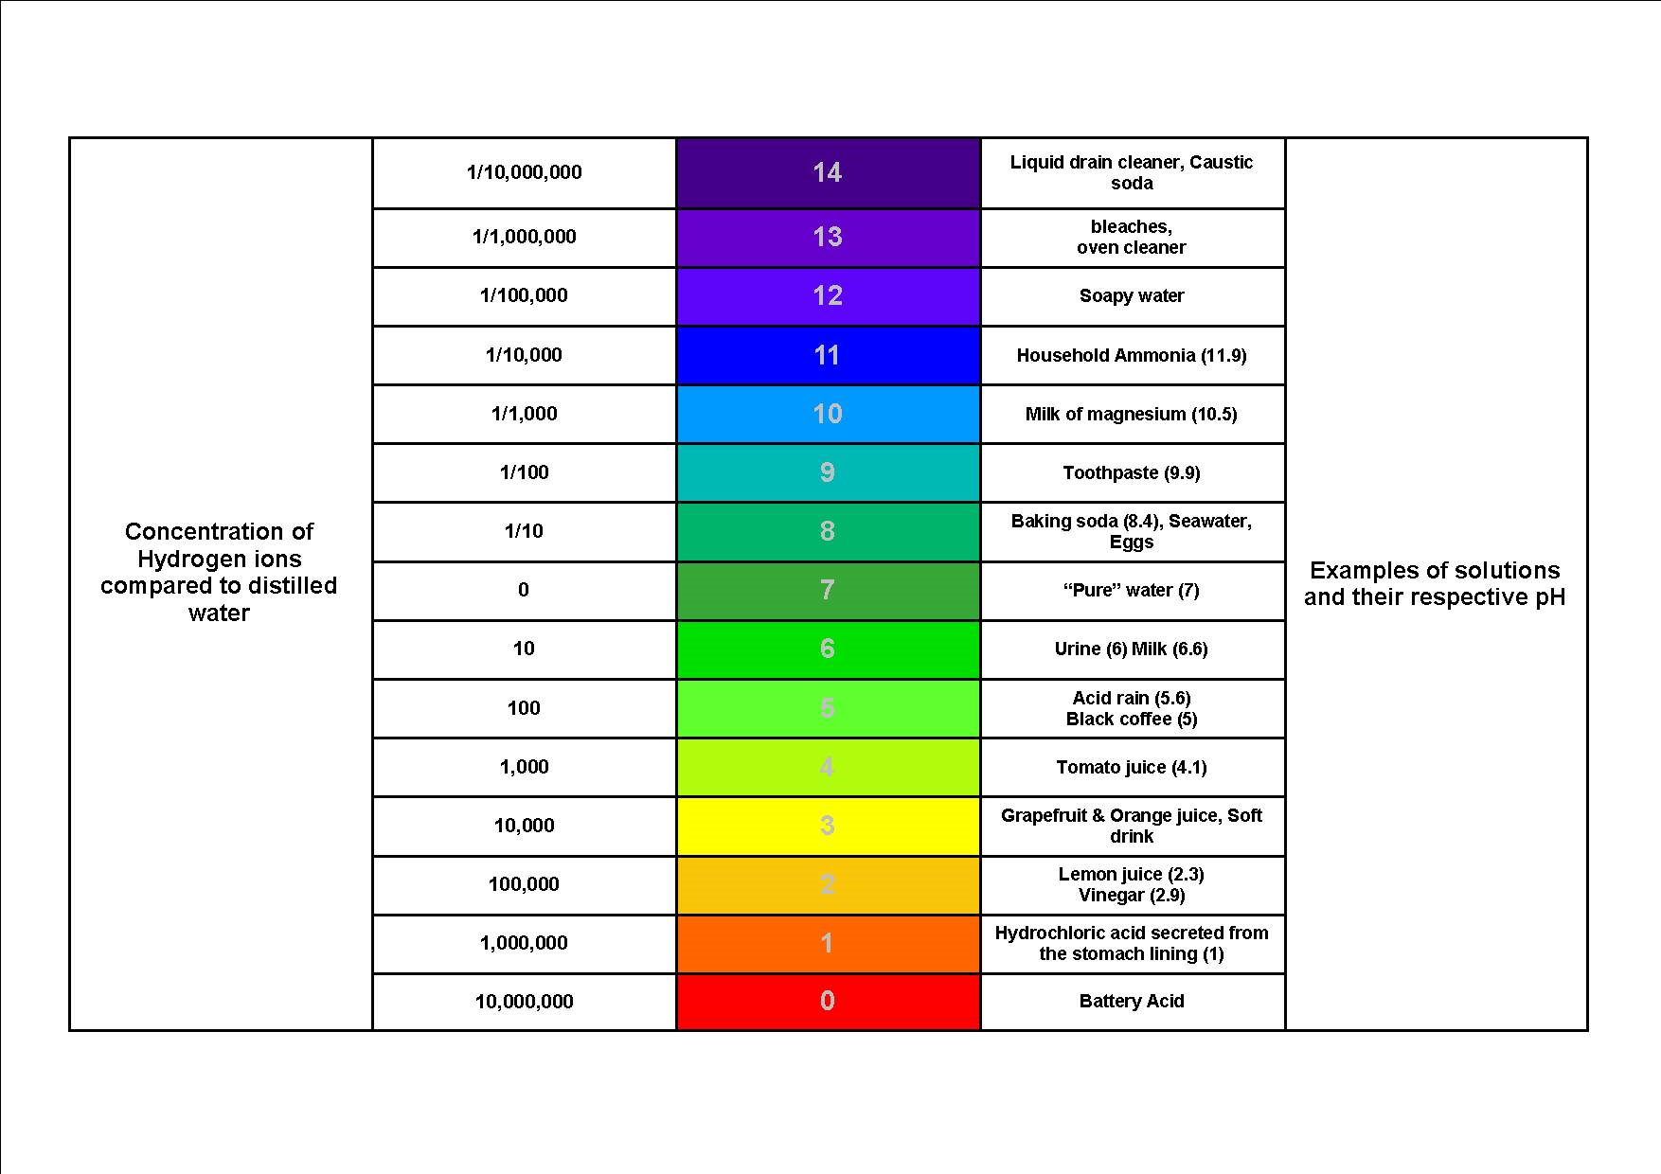
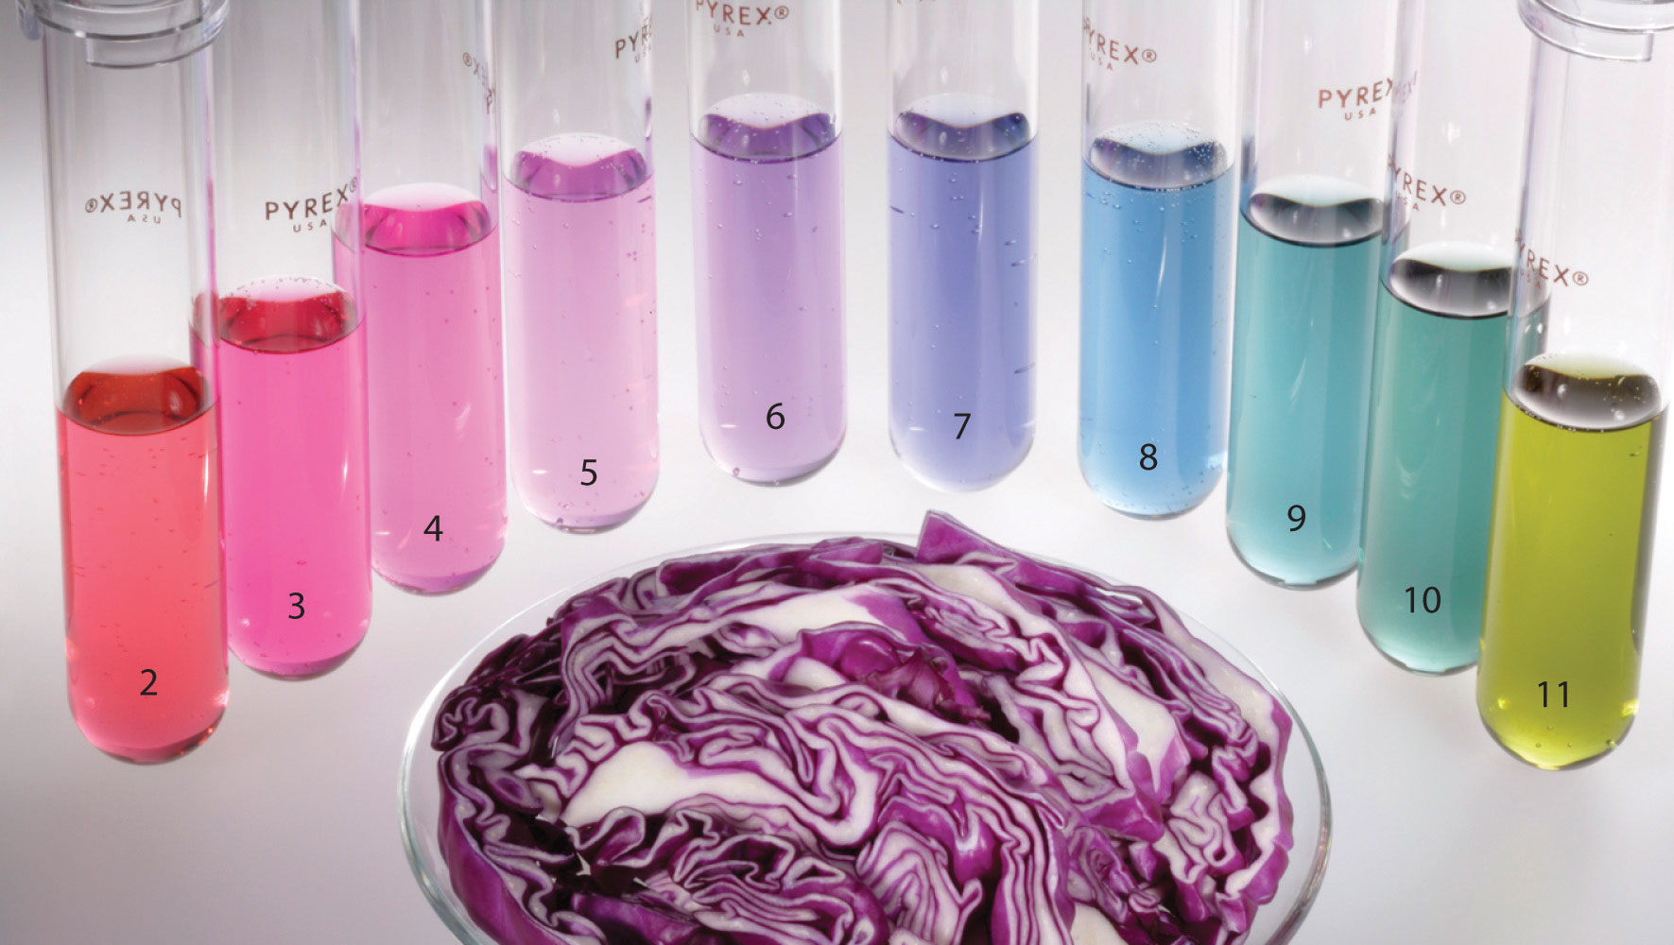
Indicator
A substance that changes color in the presence of an acid or base.
Ex. Cabbage Juice, litmus paper

Slide 10
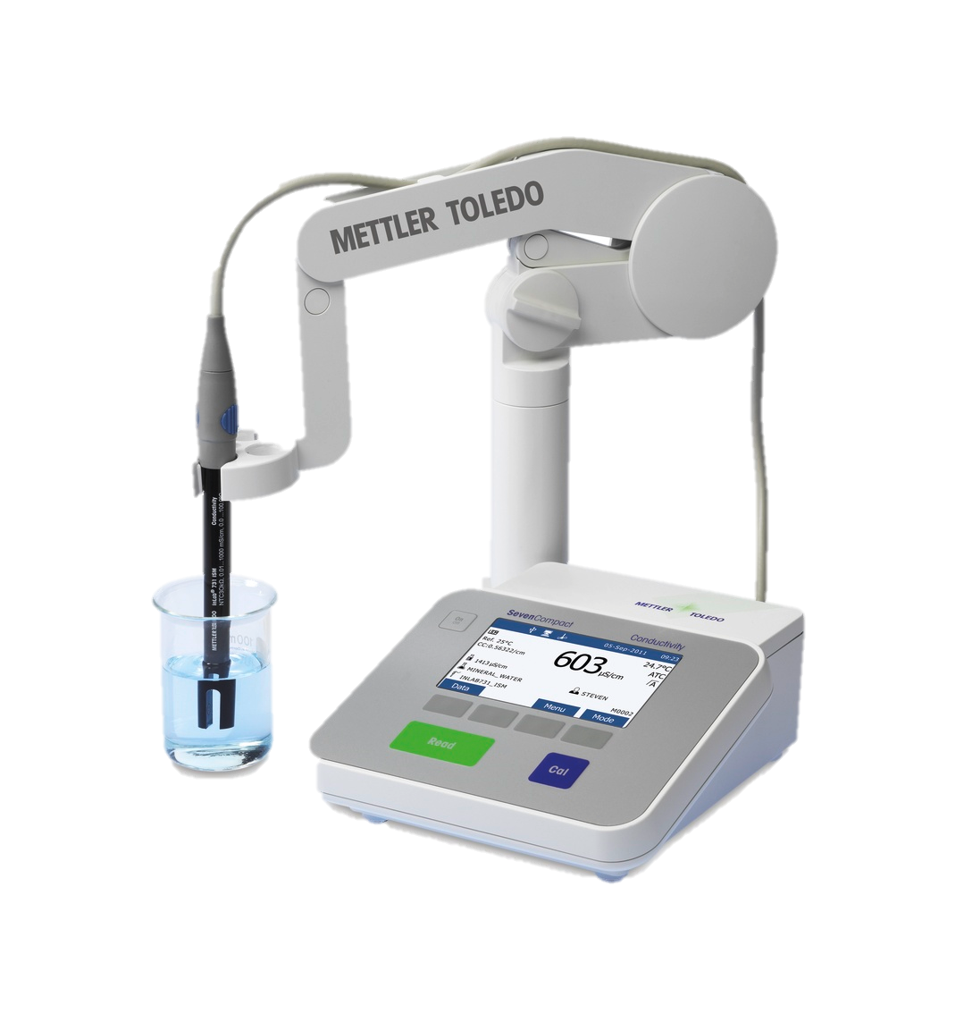
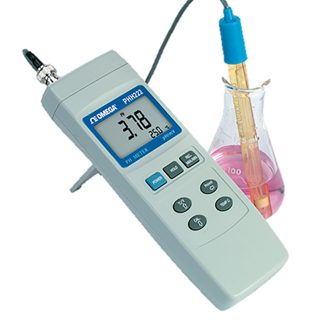
pH meter
PH meter is a electric device used to measure hydrogen-ion activity (acidity or alkalinity) in water based solutions indicating its acidity or alkalinity expressed as pH.
It provides a value as to how acidic or alkaline a liquid is. For e g. acids dissolve in water and form positively charged hydrogen ions (H+). The greater this concentration of hydrogen ions, the stronger the acid is.
Fundamentally, a pH meter consists of a potentiometer attached to a pH responsive electrode and a reference (unvarying) electrode. The difference in electrical potential relates to the acidity or pH of the solution.

Slide 11
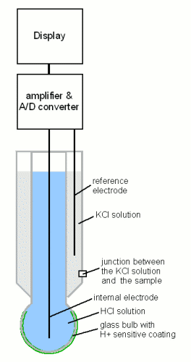
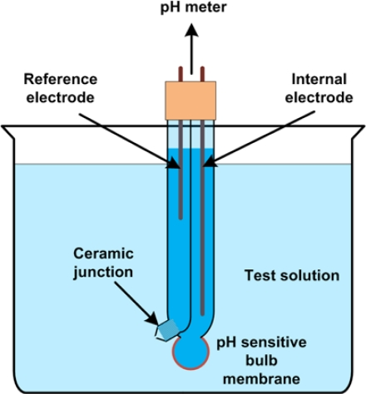
Probe
Actually measuring a voltage – a charge differential – between a control solution and the external fluid.

Slide 12
Question time . You next lecture is related to Amino acid
Sayfeddin saad

