Slide 1
Ministry of Higher Education
and Scientific Research
University of Ishik
College of education
Department of Biology
Practical Ecology
Ecosystems and Food Chains
6th lab.
2017- 2018 (3rd Grade)
By: Yadasht Haydar

Slide 2
QUIZ :D :D
Write types of biodiversity .
Write 2 Social benefits of biodiversity .

Slide 3
Ecosystems
Groups of living things and the environment they live in make up an ecosystem.
All living things can meet their basic needs there.
Ex. Beaver pond, ocean, forest, parking lot

Slide 4
Communities
Communities are made up of all the populations that live in the same area.
The plants and animals that live together depend on one another to survive.

Slide 5
Populations
A group of the same species living in the same place at the same time.
Ex. Tadpoles, deer, trout

Slide 6
Habitat A habitat (which is Latin for "it inhabits") is an ecological or environmental area that is inhabited by a particular species of animal, plant or other type of organism.
A habitat that meets the needs of an organism.
Habitats may include small parts of an ecosystem or the entire ecosystem.
Ex. Birds often use the entire ecosystem, while a fungi may only need a log in the ecosystem to meet its needs.

Slide 7
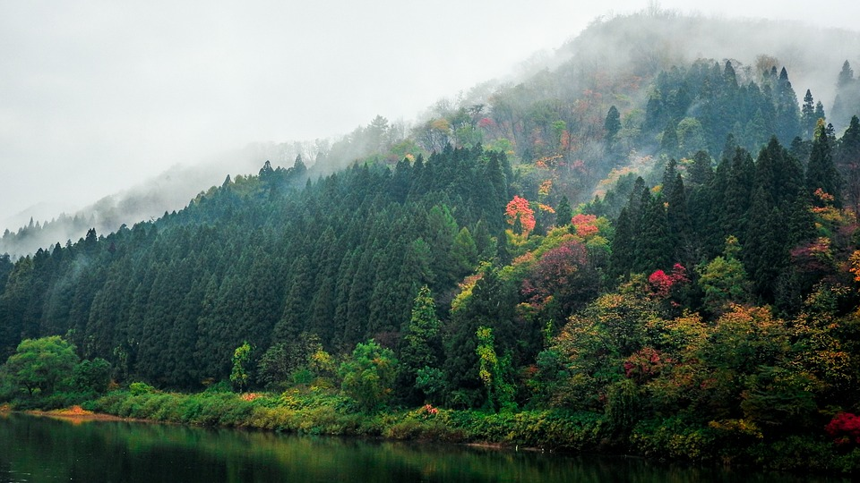
Types of Habitat
Aquatic Habitats
Desert Habitats
Forest Habitats
Grassland Habitats
Tundra Habitats

Slide 8
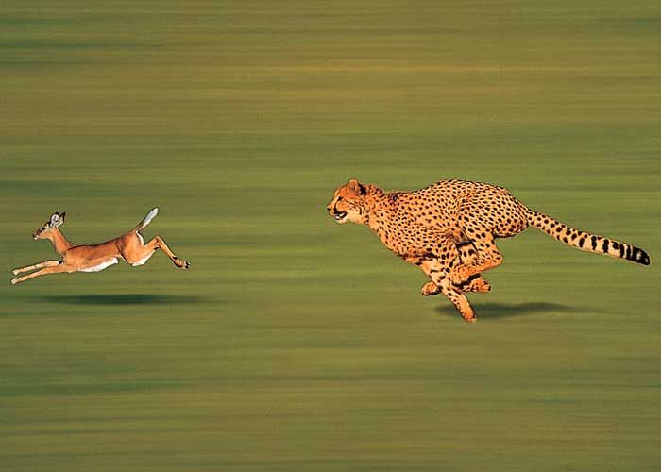
Animal Niches An ecological niche is the role and position a species has in its environment; how it meets its needs for food and shelter, how it survives, and how it reproduces. A species' niche includes all of its interactions with the biotic and abiotic factors of its environment

Slide 9
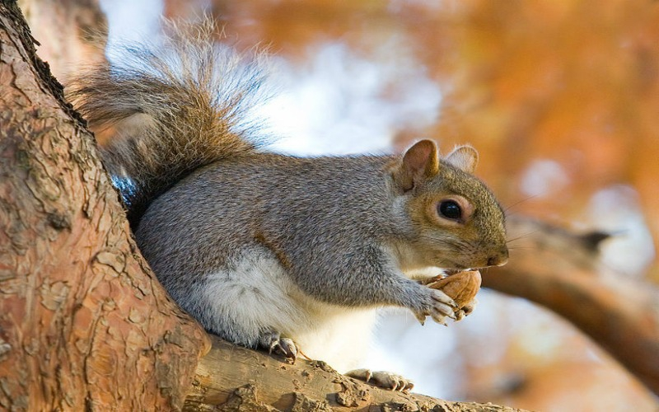
Animals have a niche or job they perform in a habitat.
Niche- an animal’s job in its environment, which includes all the ways it meets its basic needs
How it gets shelter
How It produces young
How it gets food and water.

Slide 10
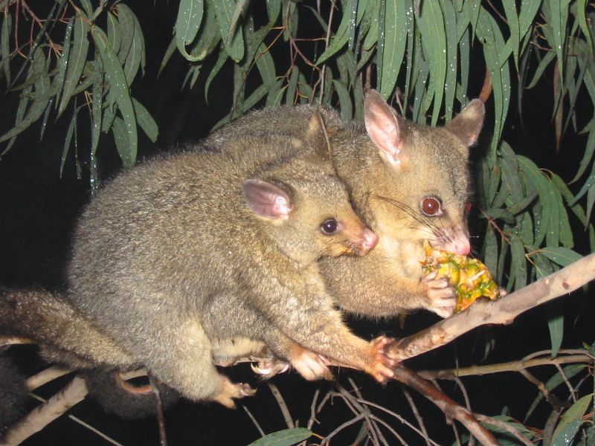
What an organism eats is an important part of its niche because what a living thing eats affects the population around it.
The sun is the main source of energy for all living things.
Animals do not get their energy directly from the sun, but they eat plants, which use sunlight to make food.
Some animals eat other animals that eat plants.

Slide 11
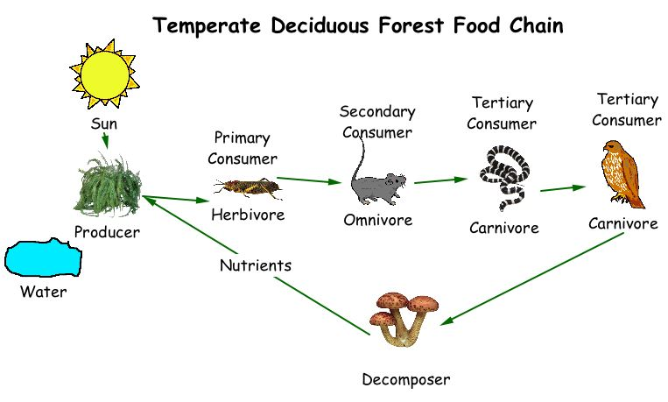
Food Chains
Food chain- a term used to describe the way energy moves through an ecosystem.
Food chains have 3 levels:
Level 1 – Producers
Level 2 – Consumers
Level 3 – Decomposers

Slide 12
Level 1 - Producers
Green plants and some protists and monerans are producers.
Producers make their own food using energy from the sun.

Slide 13
Level 2 Consumers
Consumers are the organism that prey on other organisms because they do not have ability to produce their own energy.
Consumers make up the next level of energy transfer.
Consumers eat other living things for energy.

Slide 14
Different Types Of Consumers
Primary consumers ( herbivores)
These are organisms which feeds on the producers or autotrophic organisms ( plants)for their energy .eg. Cow,goat,elephants etc
Secondary consumers (carnivores)
These feeds on primary consumers for their energy .eg.,dogs,snakes,owls. The organisms which feed on both producers and consumers is als known secondary consumers(omnivores) eg. Human, bears etc
Tertiary consumers ( large carnivores)
These are carnivores that feeds only on secondary consumers.eg.,lion,tiger,eagle etc

Slide 15
Level 3 Decomposers
Decomposers are the organisms that breaks down the cells of dead plants and animals into simpler substance.eg. certain kinds of bacteria, actinolites,worms,slugs etc
Decomposers eat dead animal remains or animal waste.
They return nutrients to the soil for plants to use as the cycle begins again.

Slide 16
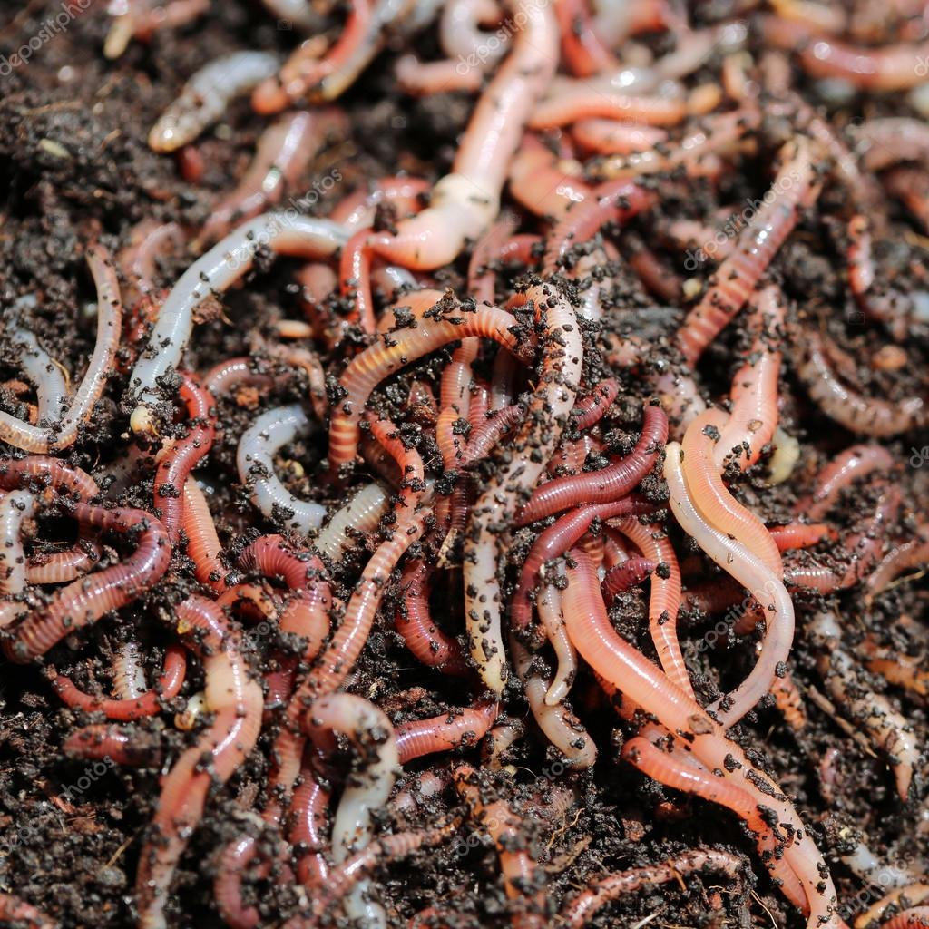
Earthworms, dung beetles, and sea cucumbers are some of the common detritivores in an ecosystem. They play a crucial role in the ecosystem, by decomposing the dead organic matter.

Slide 17
EAT
Break Down
Snails eat algae and when the snail dies, fungi break down its body.

Slide 18
EAT
Break Down
Blueberry Bushes grow in sunny areas at the edge of a forest. Black Bears eat the blueberries and bacteria in the soil decompose the bear’s waste.

Slide 19
Energy Pyramids
Energy pyramids are diagrams that show how much food energy is passed from one organism to another along the food chain.
The base represents producers, which have the most energy to pass on.
The other levels represent consumers.
As energy is transferred up the pyramid, it is lost.
Only about 10% of energy is passed to the next level.

Slide 20
Energy Pyramid

Slide 21
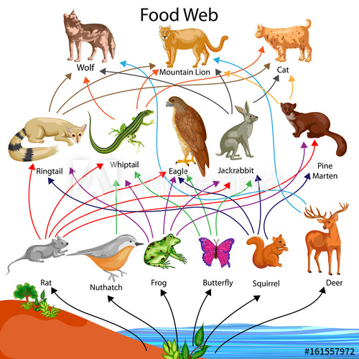
Food Webs
A food chain shows one pathway for energy from organism to organism in an ecosystem, but most animals get energy from more than one source.
Food web – A diagram that shows how these food chains connect and overlap.

Slide 23
Causes of Change
Some changes affect other organisms.
As animals eat plants or other animals, they reduce the number of organisms in their habitat.
When there are too many animals in a population, food may become scarce and some animals may die of starvation or move.
Some changes affect nonliving parts of an ecosystem. Worms and lichens break down soil and rock.
IN TIME, NATURE BALANCES ITSELF.

Slide 24
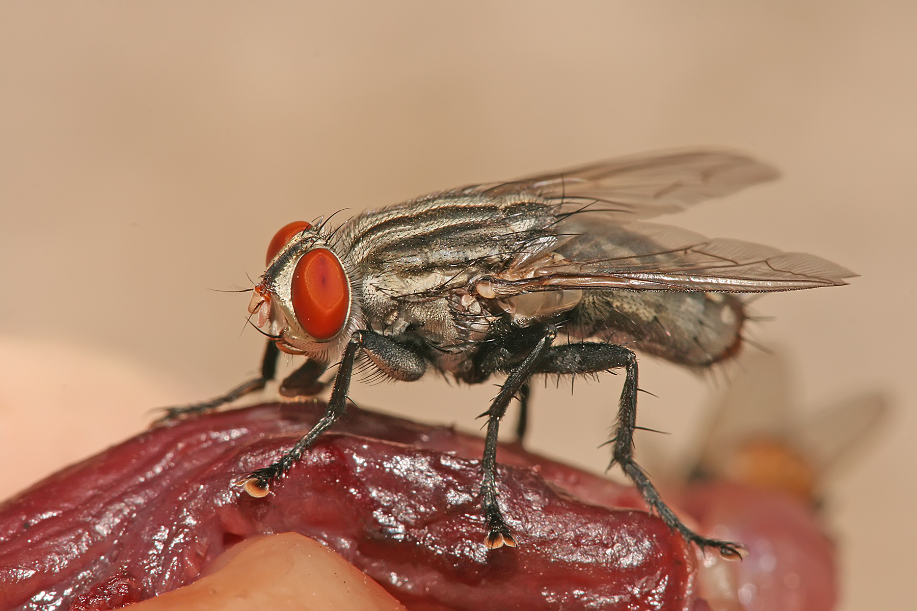
Important terms
Predator - an animal that hunts other animals for food.
Prey - an animal that is hunted for food.
Scavenger - an animal that eats the remains or waste of another animal. (EX: Vulture) They eat the parts that the predators won't eat.

Slide 25
THANK YOU FOR YOUR ATTENTION ☺
ANY QUESTIONS ?????

